Slide 1





AIMH Lab Approaches for
Deepfake Detection
Davide Alessandro Coccomini, Roberto Caldelli, Andrea Esuli, Fabrizio Falchi, Claudio Gennaro, Nicola Messina, Giuseppe Amato

Slide 2
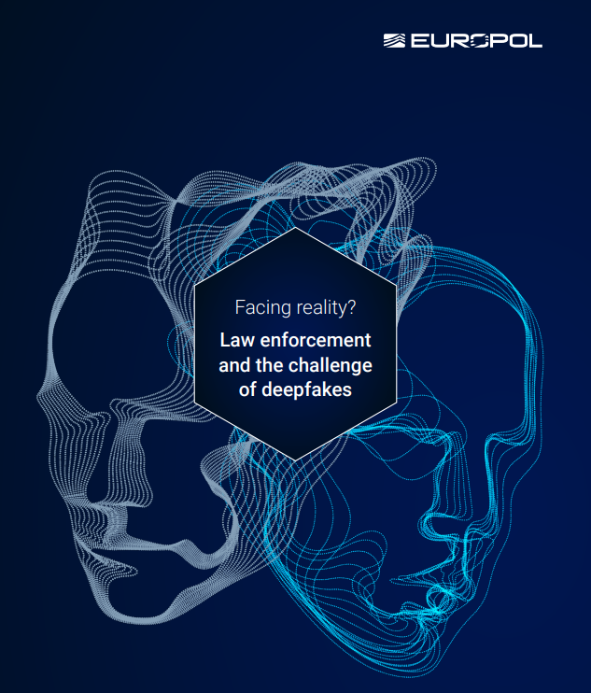
90%
… of online contents will be synthetic by 2026

Slide 3


Slide 4
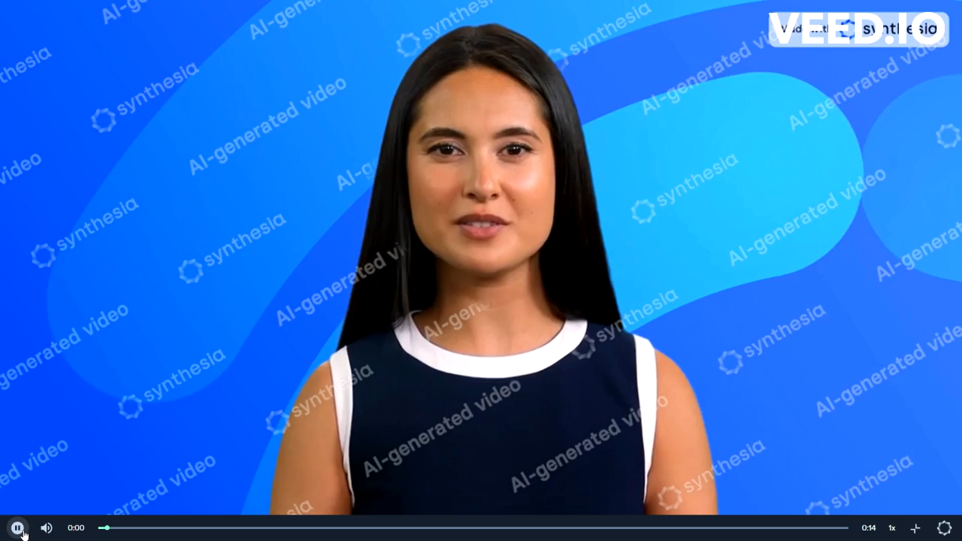

Slide 5
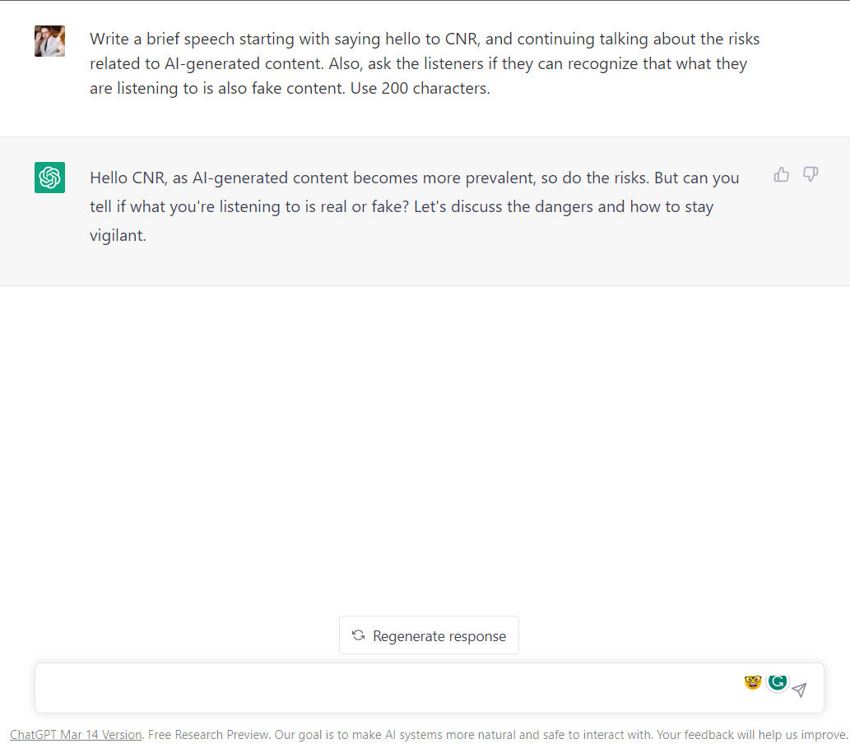
Davide Coccomini

Slide 6
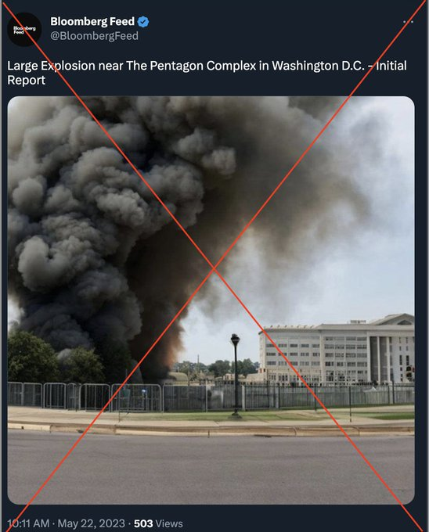
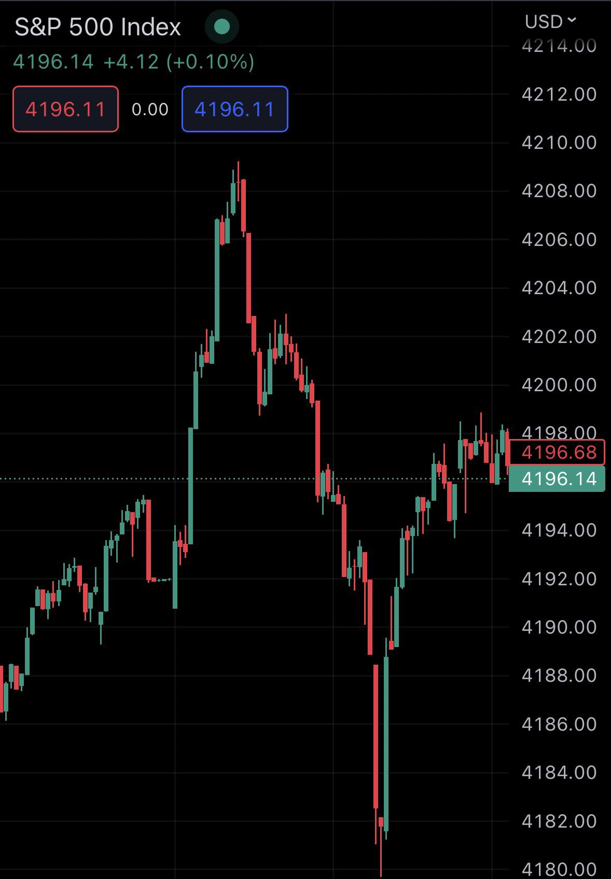
Davide Coccomini

Slide 7
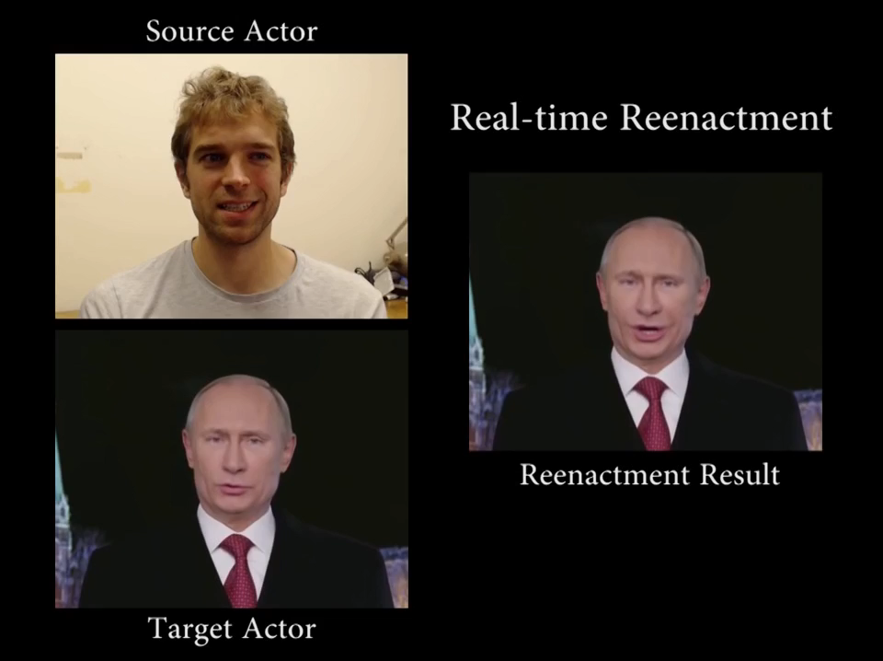

Slide 8
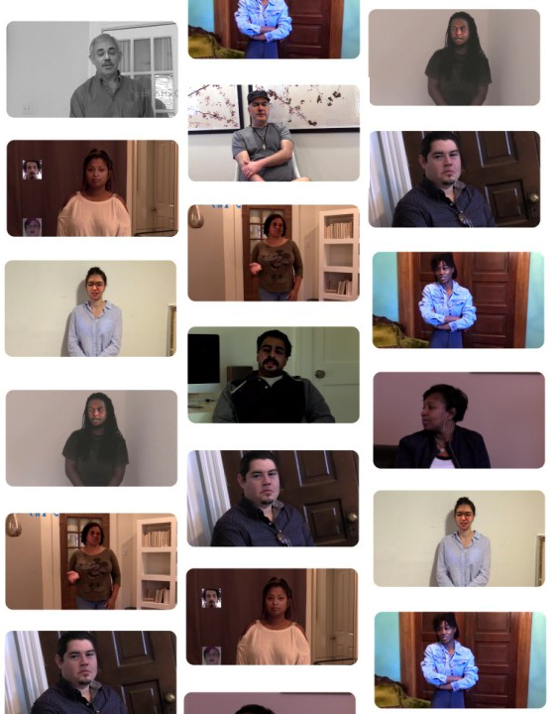



Deepfakes
Why should we care?
Destroy people reputation
Undermine the justice system
Cause tensions between countries
Davide Coccomini

Slide 9








Challenges in Deepfake Detection
Evolving Technology
Adversarial Attacks
Lack of Generalization
Lack of Interpretability
Data Availability
No standards
Computational Resources
Real world situations
Davide Coccomini

Slide 10




Deepfake Detector
Face Detection
Preprocessing Pipeline
Model Architecture
Evaluations
Davide Coccomini

Slide 11

Combining EfficientNet and Vision Transformer for Video Deepfake Detection

Slide 12


Cross Efficient Vision Transformer
Small or big patches? Both!
Deeper EfficientNet B0
Transformer Encoder
MLP
Cross-Attention
Mechanism
+
CLASS
Smaller EfficientNet B0
Transformer Encoder
MLP
Coccomini, D.A., Messina, N., Gennaro, C., Falchi, F. (2022). Combining EfficientNet and Vision Transformers for Video Deepfake Detection. In: Sclaroff, S., Distante, C., Leo, M., Farinella, G.M., Tombari, F. (eds) Image Analysis and Processing – ICIAP 2022. ICIAP 2022. Lecture Notes in Computer Science, vol 13233. Springer, Cham.

Slide 13

Which Deep Learning architecture generalize better?

Slide 14
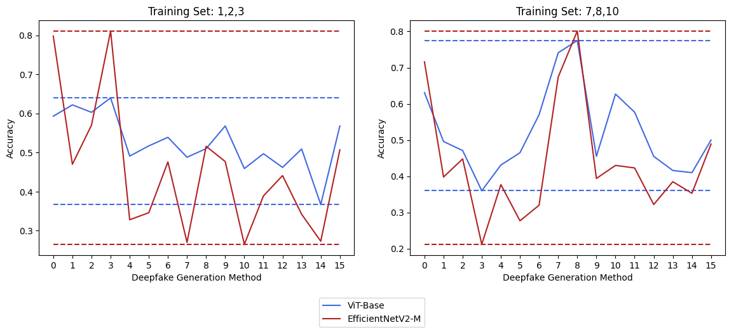

Cross-Forgery Analysis of Vision Transformers and CNNs for Deepfake Image Detection
Accuracy on ForgeryNet
Vision Transformers generalize better on Image Deepfake Detection!
Coccomini D.A., Caldelli R., Falchi F., Gennaro C., and Amato G. (2022). Cross-Forgery Analysis of Vision Transformers and CNNs for Deepfake Image Detection. In Proceedings of the 1st International Workshop on Multimedia AI against Disinformation (MAD '22). Association for Computing Machinery, New York, NY, USA, 52–58.

Slide 15
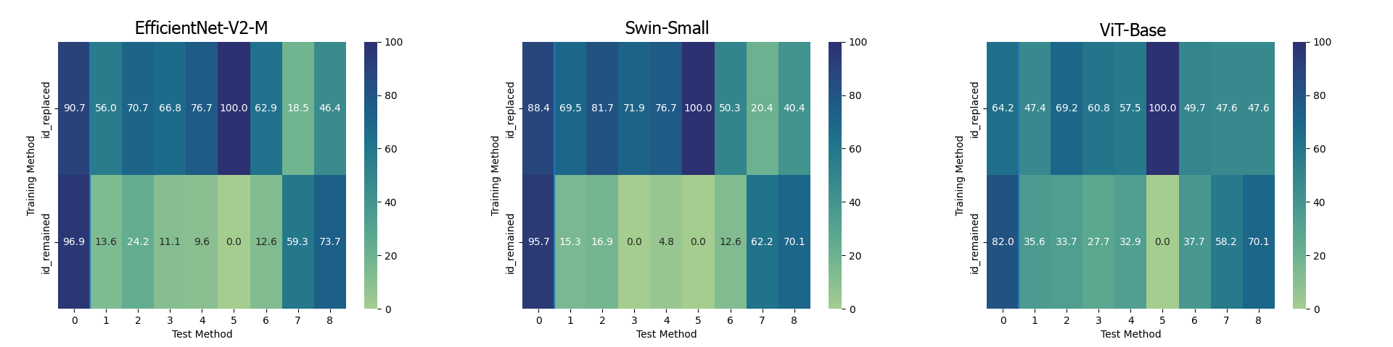

On the Generalization of Deep Learning models in Video Deepfake Detection
Accuracy on ForgeryNet
Vision Transformers generalize better also on Video Deepfake Detection!
Coccomini, D.A.; Caldelli, R.; Falchi, F.; Gennaro, C. On the Generalization of Deep Learning Models in Video Deepfake Detection. Preprints 2023, 2023030161.

Slide 16

MINTIME
Multi-Identity Size Invariant TimeSformer for Video Deepfake Detection

Slide 17
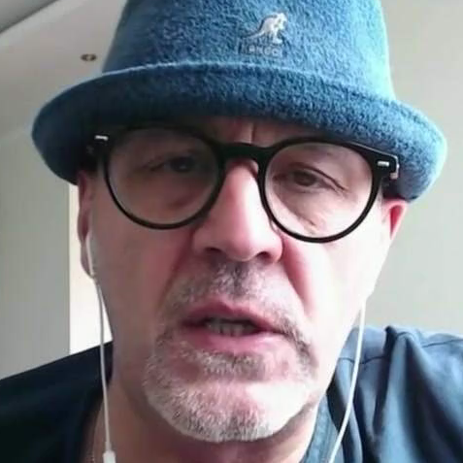
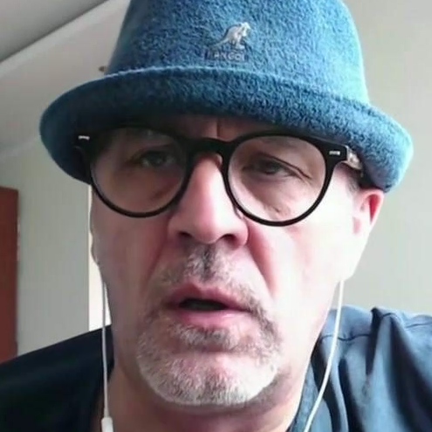

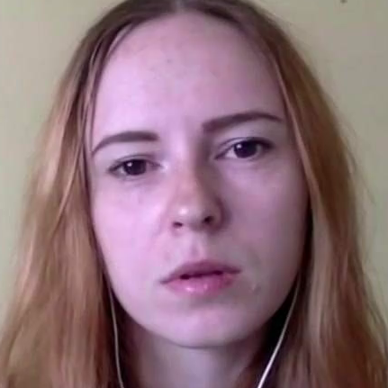
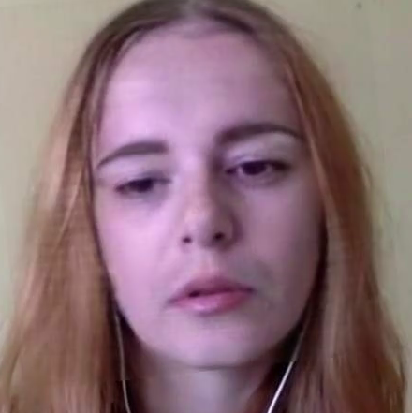
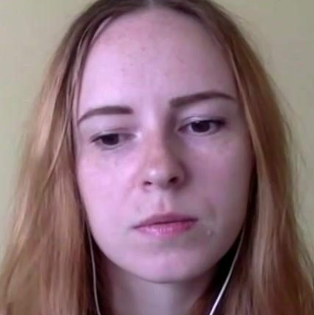
Multi-Identity Size Invariant TimeSformer
Pristine/Fake
#
Temporal-Coherent
Positional Embedding
#
Token
Size Embedding
MLP Head
TimeSformer with Identity-Based Attention
0
1
2
2
2
3
2
4
2
5
1
6
1
7
1
8
1
9
4
10
4
11
4
12
4
1
3
2
3
3
3
4
3
5
3
6
3
7
3
8
3
9
4
10
4
11
4
12
4
[CLS]
Linear Projection
Pre-Trained Convolutional Neural Network
0 / 12% 10 / 8% 20 / 21% 0 / 17% 10 / 17% 20 / 22%
Frame Number / Area Ratio (%)
Coccomini, D.A., Zilos, G.K., Amato, G., Caldelli, R., Falchi, F., Papadopoulos, S., & Gennaro, C. (2022). MINTIME: Multi-Identity Size-Invariant Video Deepfake Detection. ArXiv

Slide 18
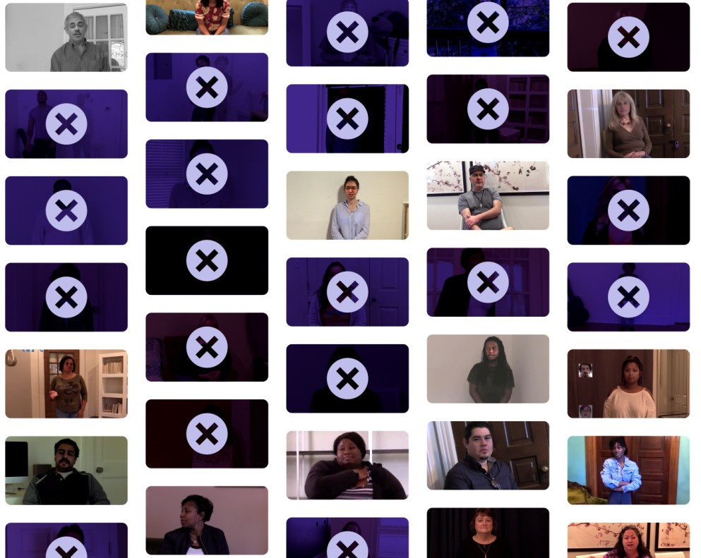
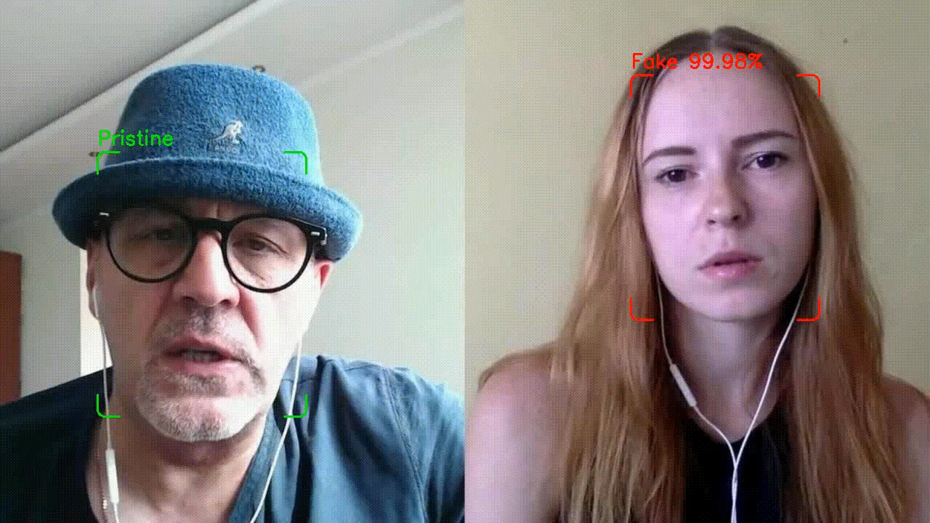
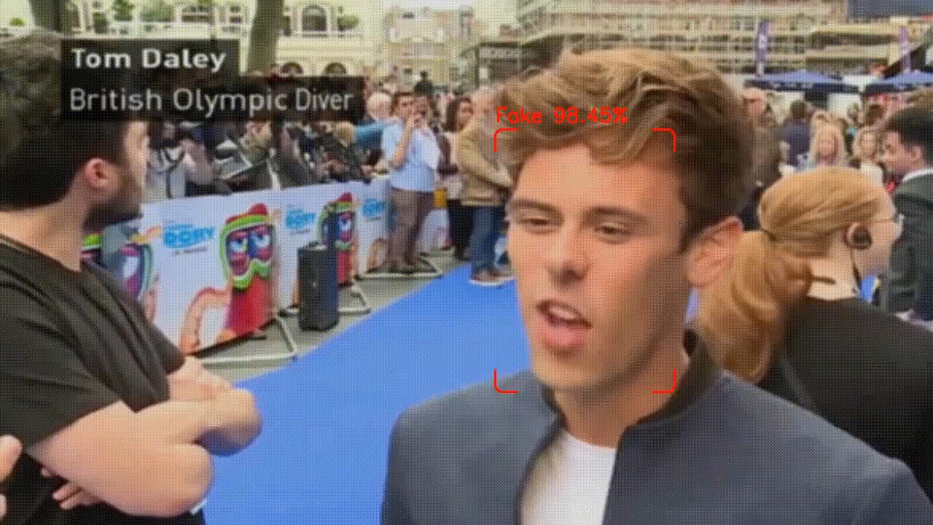
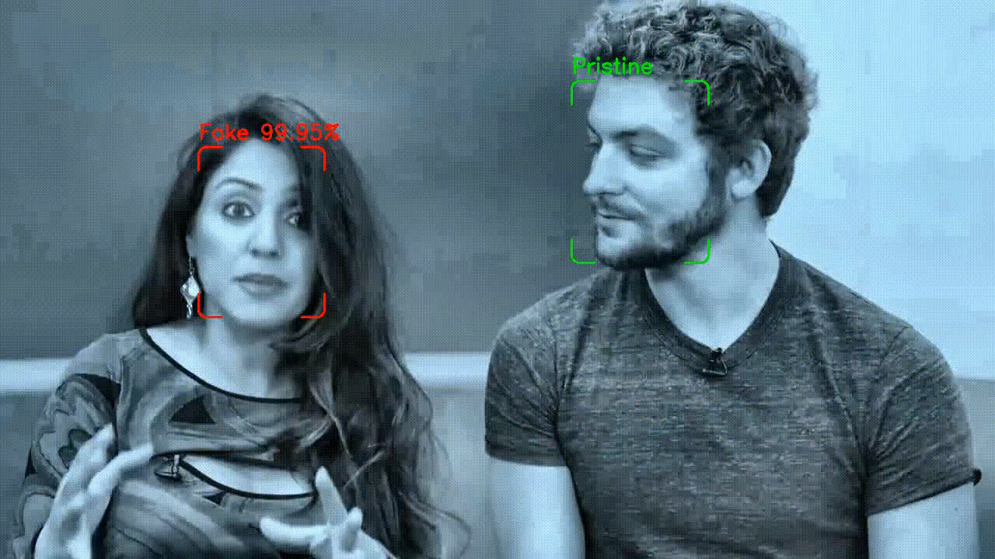
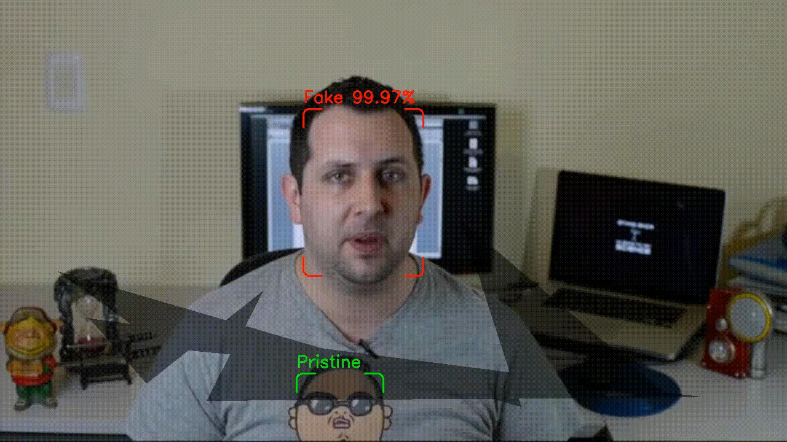

Slide 19

Detecting Images Generated by Diffusers

Slide 20
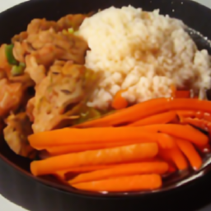
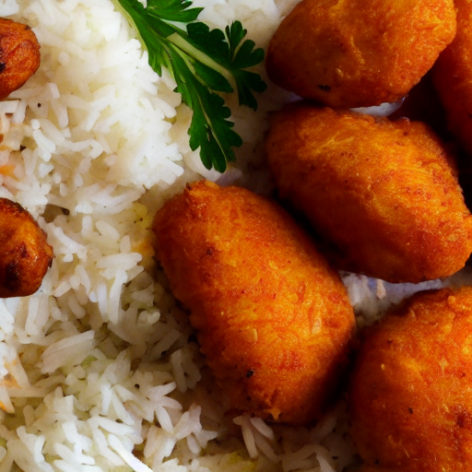
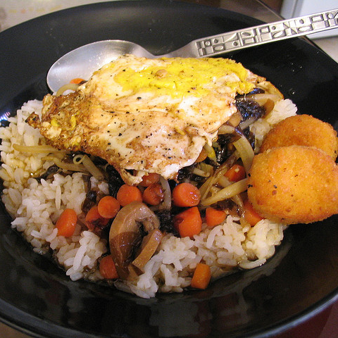
Which of these images are fake?
Description: A dish with rice, carrots and hush puppies*
1
2
3
GLIDE
Stable Diffusion
Real World
*Hush puppies -> Frittelle di Farina

Slide 21
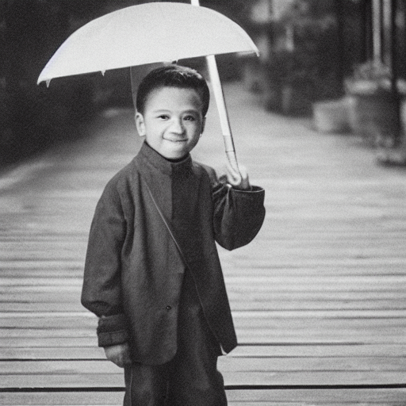
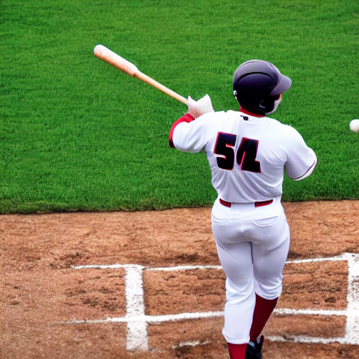
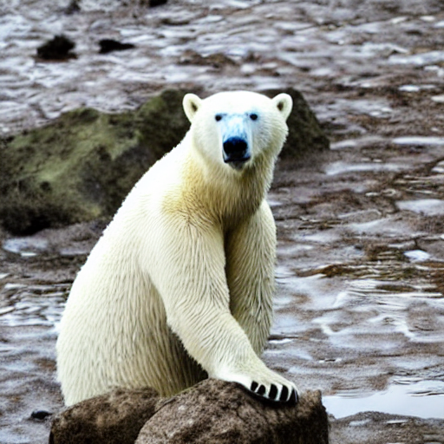
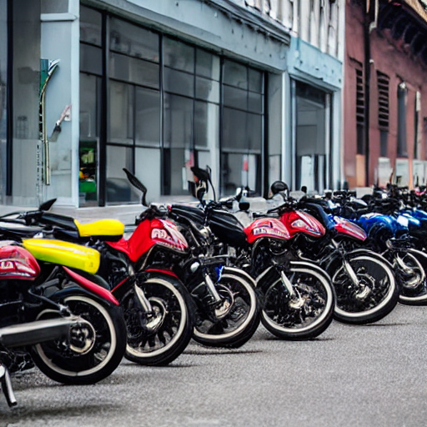

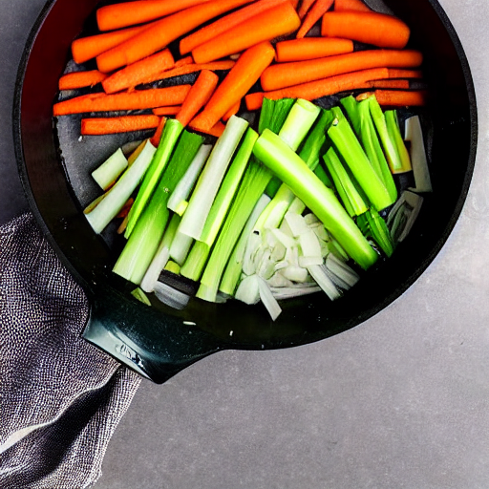
How did classifiers perform?
In-Method
Cross-Method
Trained and tested with images generated with the same method
Trained on images generated with Stable Diffusion and tested on images generated with GLIDE and viceversa
ResNet50 Image-Only
Up to 97% accuracy
MLP-CLIP Image+Text
Up to 70% accuracy
vs
Resnet50 Image-Only
Up to 61% of accuracy
Worst performances on inanimate objects
Animated
Inanimate
Coccomini, D.A., Esuli, A., Falchi, F., Gennaro, C., & Amato, G. (2023). Detecting Images Generated by Diffusers. ArXiv, abs/2303.05275.

Slide 22




Thank You
Any question?
Scan for all the papers:
Reach me on…
Or write me an email at:
davidealessandro.coccomini@isti.cnr.it

Slide 23
Supplementary Slides

Slide 24
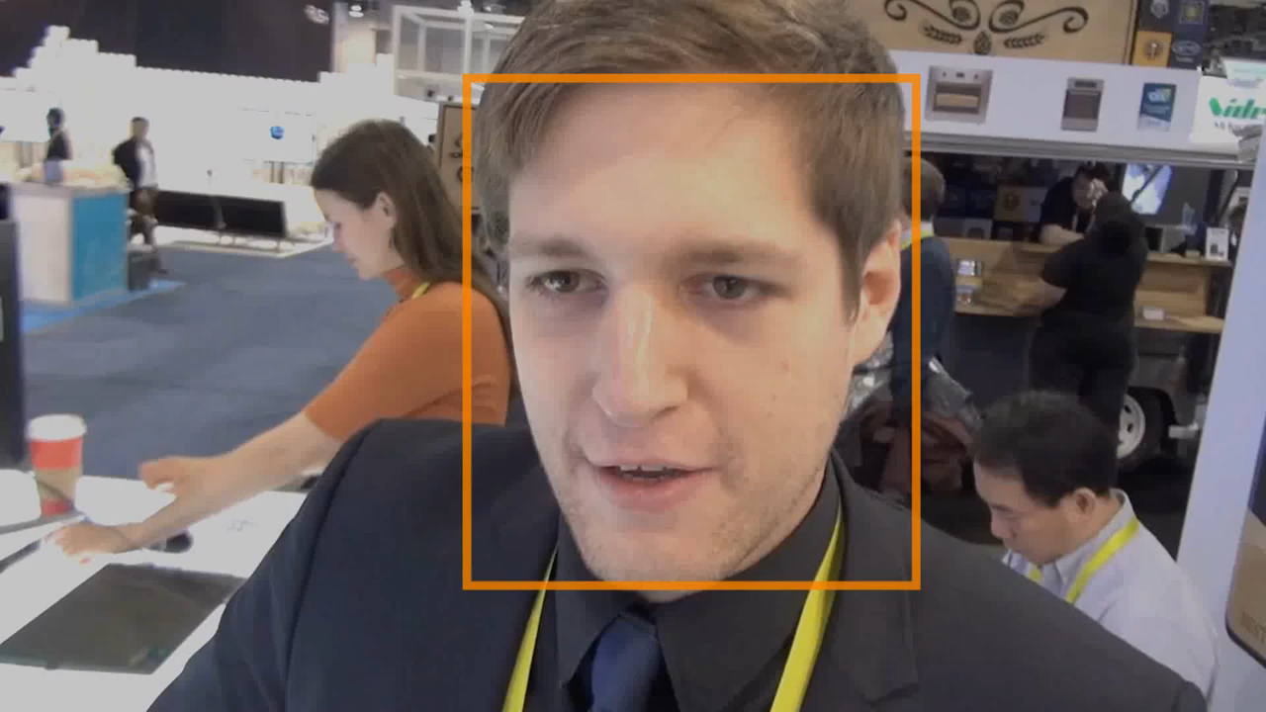



Face Detection
Detect face-only or with background
Choose the correct detector
Refine the detection parameters
Clean the data

Slide 25


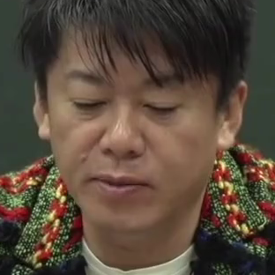
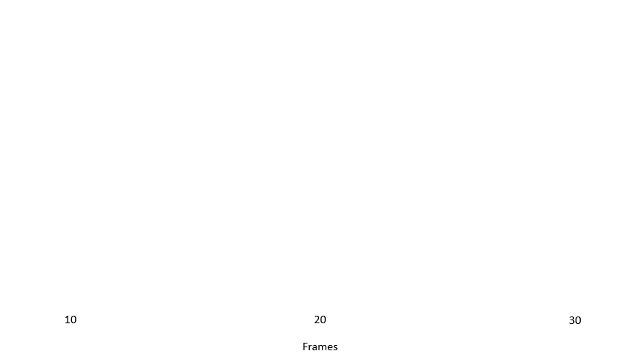
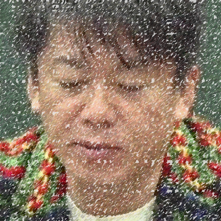
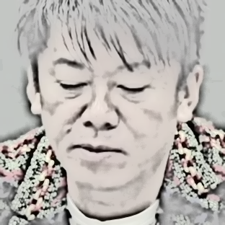
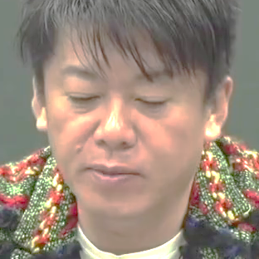

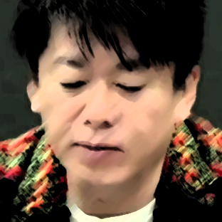
Preprocessing Pipeline
Data
Augmentation
Identity
Clustering

