Slide 1
Improving Citizen Inclusivity through Conversational AI.
The PROTECT Approach
Emanuele Pucci¹, Isabella Possaghi², Claudia Maria Cutrupi², Marcos Baez³, Cinzia Cappiello¹, Maristella Matera¹, Ludovia Piro¹ , Emanuele Pucci¹, Maria Francesca Costabile², Rosa Lanzilotti², Antonio Piccinno²
Politecnico di Milano, Italy
Università degli Studi di Bari Aldo Moro, Italy
¹{name.surname}@.polimi.it, ²{name.surname}@uniba.it
Notes:
Hi everyone, I am Emanuele Pucci from Politecnico di Milano and today also on behalf of my colleagues I’ll present our project named “Protect Approach”, in collaboration with università degli studi di bari aldo moro.

Slide 2
“From 2025, Member States will be required to grant all citizens, and specifically people with disabilities, full and
effective participation in society, providing information
access through multiple channels and perceivable and
comprehensible modalities.”
European union. directive (eu) 2019/882 of the european parliament and of the council of 17 april 2019 on the accessibility requirements for products and services.
Notes:
In theory, From 2025, Member States will be required to grant all citizens, and specifically people with disabilities, full and effective participation in society, providing information
access through multiple channels and perceivable and comprehensible modalities. Yet, if we look at the reality, things radically change.

Slide 3
“I cannot detect how the content is structured. The real problem is [...] not being able to find the right information”.
Participant1
Notes:
This is a powerful claim, made by one of ours participants during our preliminary study.
I cannot detect how the content is structured. The real problem is [...] not being able to find the right information
We worked with blind and visually impaired participants to understand problems in web navigation and we think this claim perfectly reflects the state of the art. The Web is still a visual experience.

Slide 4
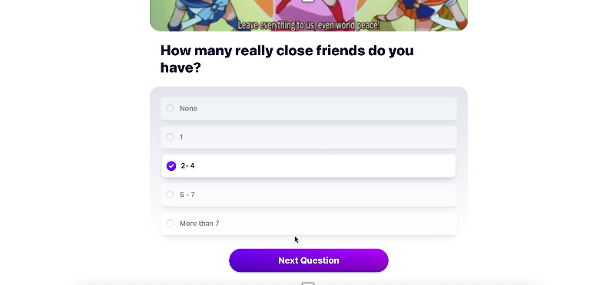
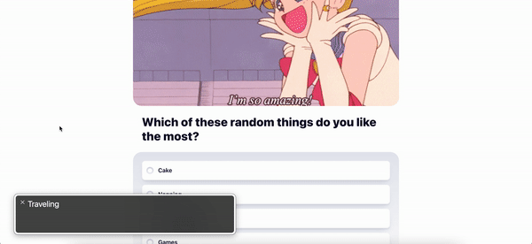
What’s wrong…
… not asking whether the Web, with its current format, is accessible to everyone!
Navigation with GUIs
Screen readers cannot interpret the form!
Notes:
We can just browse the web to find examples of how difficult it is, to have a quality experience on the web with accessible technologies. Here for example, we can see how the same form, although extremely easy to fill-in with a visual support, becomes completely inaccessible when using screen readers.

Slide 5
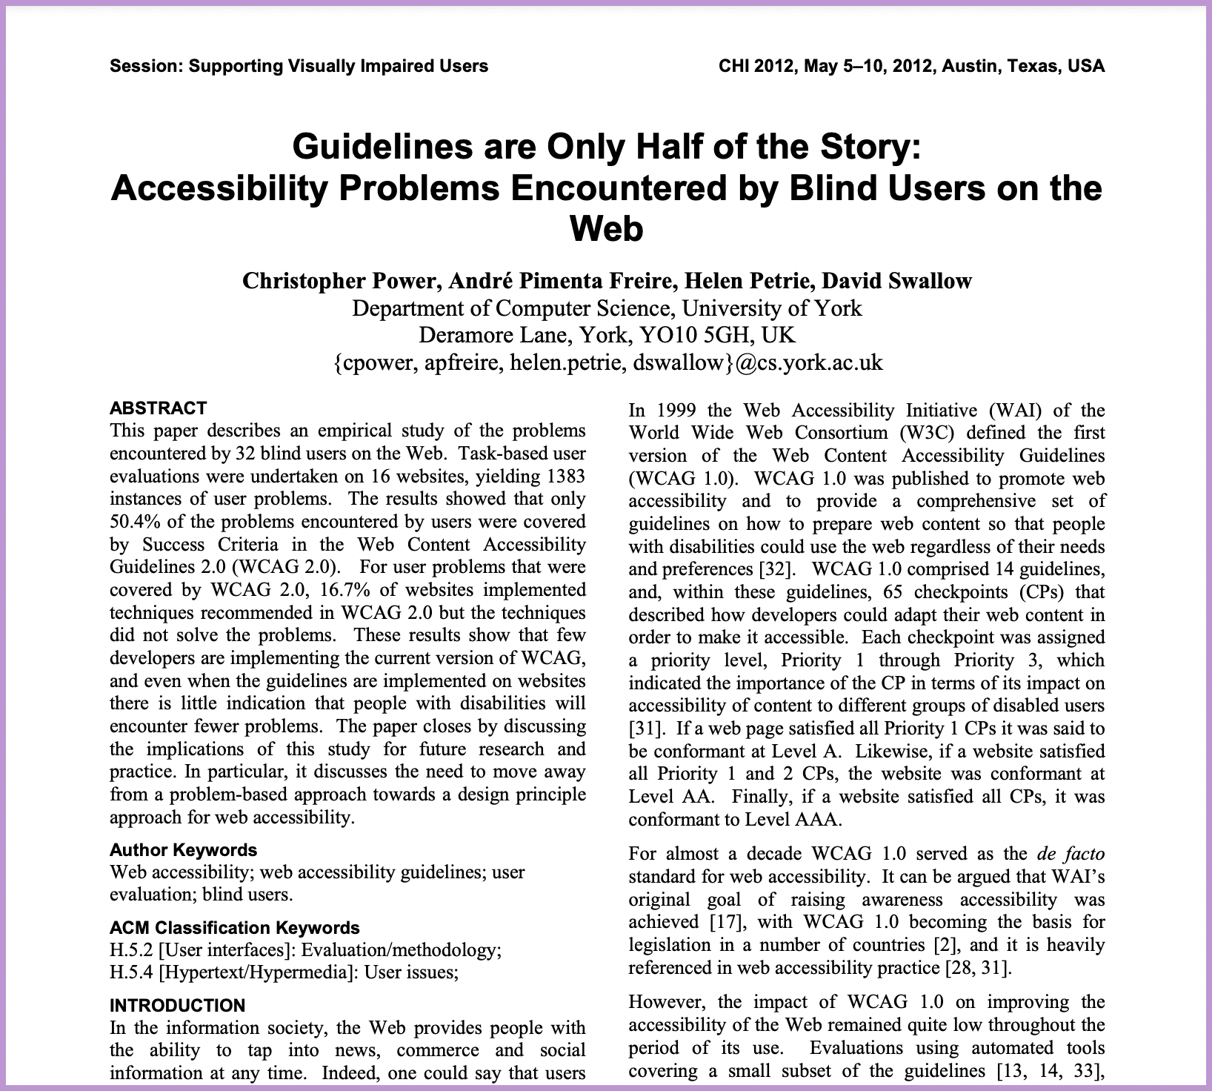
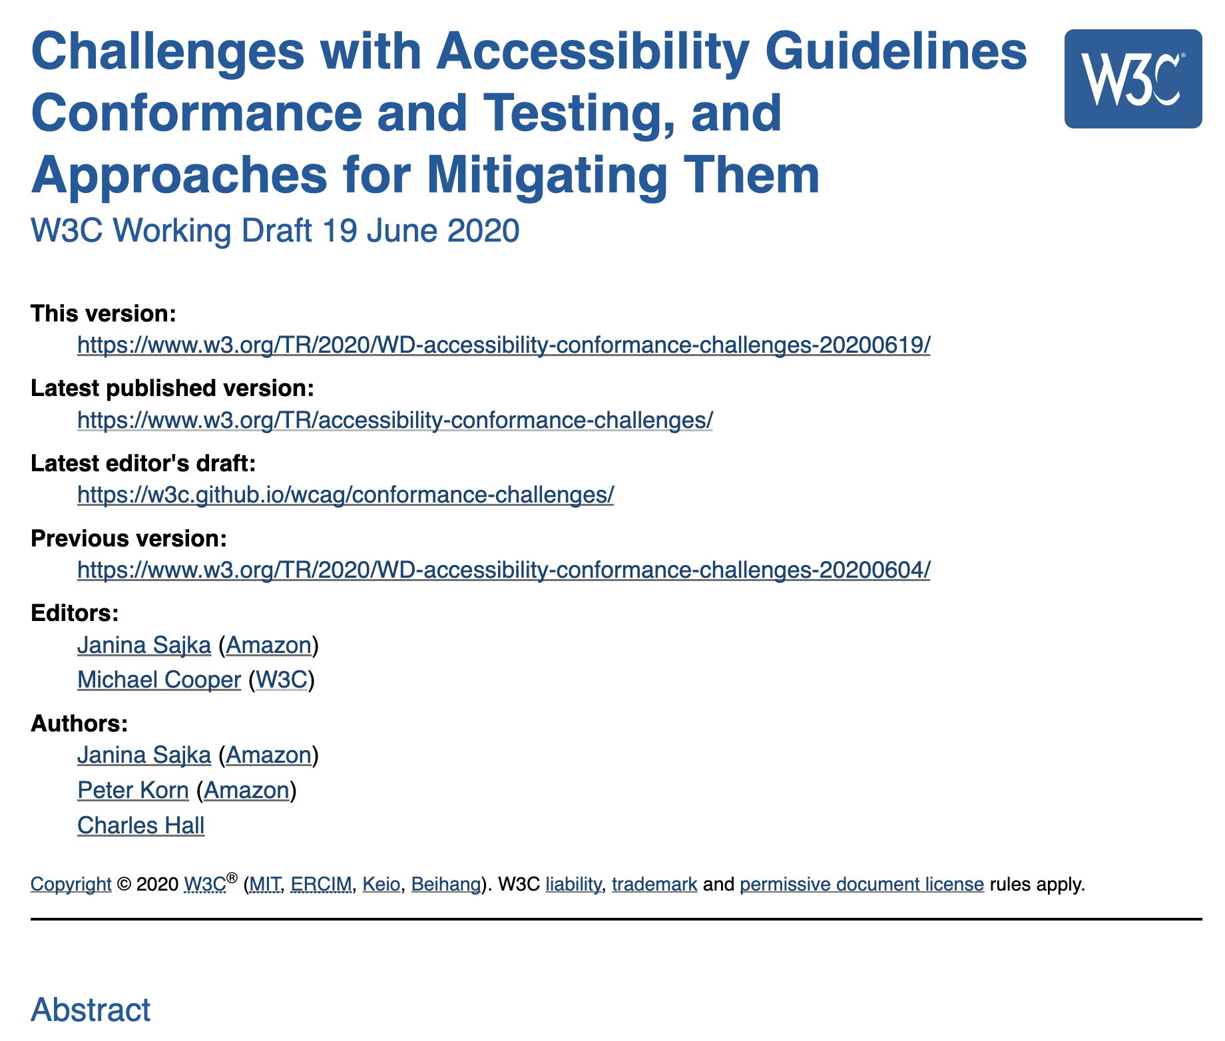
WCAG and guidelines are not enough
The majority of Web Challenges
are not addressed
Guidelines are only partially
and arbitrarily applied
When applied, guidelines are
often not correctly implemented
Notes:
There are guidelines, for sure, yet the problem is that the most part of web challenges are not addressed by them. Moreover, when applied, guidelines improve especially the technical accessibility of the Web page code without focusing that much on the quality of the user experience, thus, making all the efforts useless.

Slide 6
Protect Approach
Conversational Web for public online services.
DGTCSI-ISCTI
Notes:
That is why we developed the protect approach, whose goal is to extend the notion of Conversational web browsing to public online services.
The main technological outcome of the project will be a demonstrator of a platform for Conversational Web browsing, supported by patterns that will be identified through a human-centered process.
Institutions and external bodies as Agenzia per l’Italia Digitale (AgID), comune di Bari and di Milano have already expressed interest and commitment for the project.

Slide 7
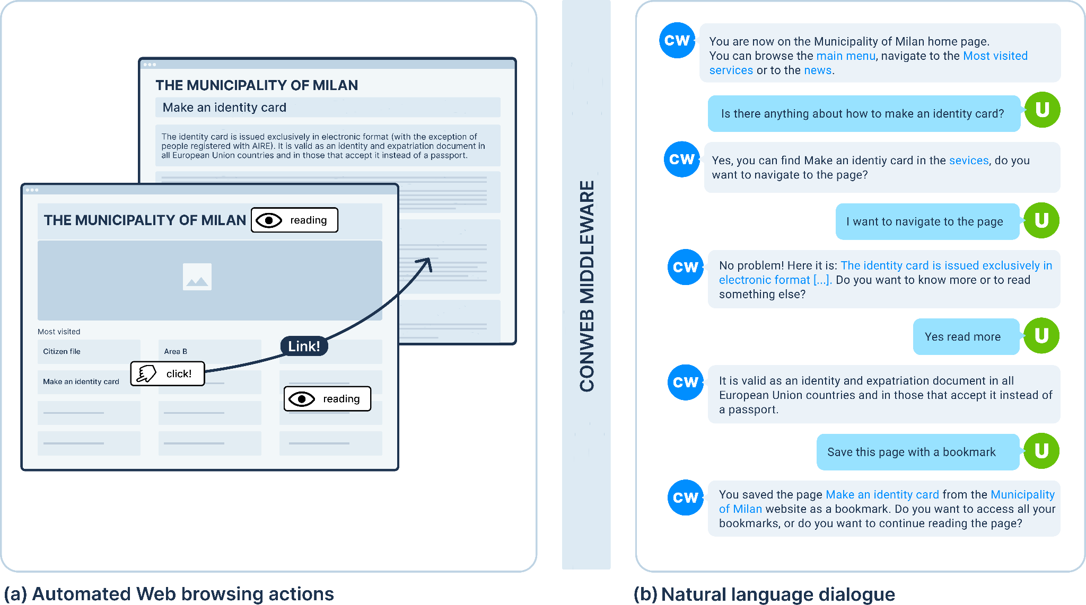
THE VISION – Towards the Conversational Web
Notes:
First, what is conversational web browsing? It is a new interaction paradigm to transform classical browsing into a dialog-based interaction.
This is the main idea behind conweb. On the left you can see reproduced an example of how a visual navigation works: the user understands the page structure, how the information is organized and can freely move behind content. He can click on a link and go very easily back and forth.
That does not happen when the same information has to be provided in a conversational form (on the right). So we have to think strategies to effectively deliver that information, in a way that the user can not only land on a webpage (which is what most of the conversational assistants do) but also explore its content and freely moving through the different pages.

Slide 8
The Framework
Notes:
The starting point will be the architecture defined through preliminary user-studies and tests.
To enable the interaction described in the past slide, a middleware sitting between the user and the website identifies the content of the website, interprets user intents and associated entities, and automatically perform related actions on the website (e.g., click, extract information).
A conversational-browsing model must be built when the website is first accessed to enable conversational browsing. Information is indexed in a sort of three and divided in nodes, where a conversation node does not necessarily correspond to an entire Web page; it can be a content paragraph, a navigation menu, a link, or any other element in the Web page that can be presented independently from the others and has a role in the progressive exploration of the website content. An NLP model is trained on the page content to match intent and entities.

Slide 9
Main Goal
Identifying challenges posed by current technologies for a more inclusive interaction with PA digital services on the Web
Promoting a human-centred process including extended (large-scale) user studies.
Defining design methodologies to define design patterns for conversational user interfaces for Web browsing of PA applications.
Designing technologies for integrating Conversational AI in Web platforms
Notes:
Identifying challenges posed by current technologies for a more inclusive interaction with PA digital services on the Web
Promoting a human-centred process including extended (large-scale) user studies.
Defining design methodologies (also as a toolkit) to define design patterns for conversational user interfaces for Web browsing of PA applications.
Designing technologies for integrating Conversational AI in Web platforms

Slide 10
THE HOW: Design Process
We followed a human-centered process, with a total of 26 BVI users, to define a design space with prominent challenges and related patterns for the ConWeb paradigm.
The insights of each phase informed the next steps and progressively guided the identification of conversational patterns for accessing the Web.
Notes:
We started from a humans centered process that involved a total of 26 blind and visually impaired participants to define a design space with prominent challenges and related patterns for the ConWeb paradigm.
The insight of each phase informed the next steps, and the involvement of blind and visually impaired participants helped us identify requirements for a paradigm detached from the visual channel.

Slide 11
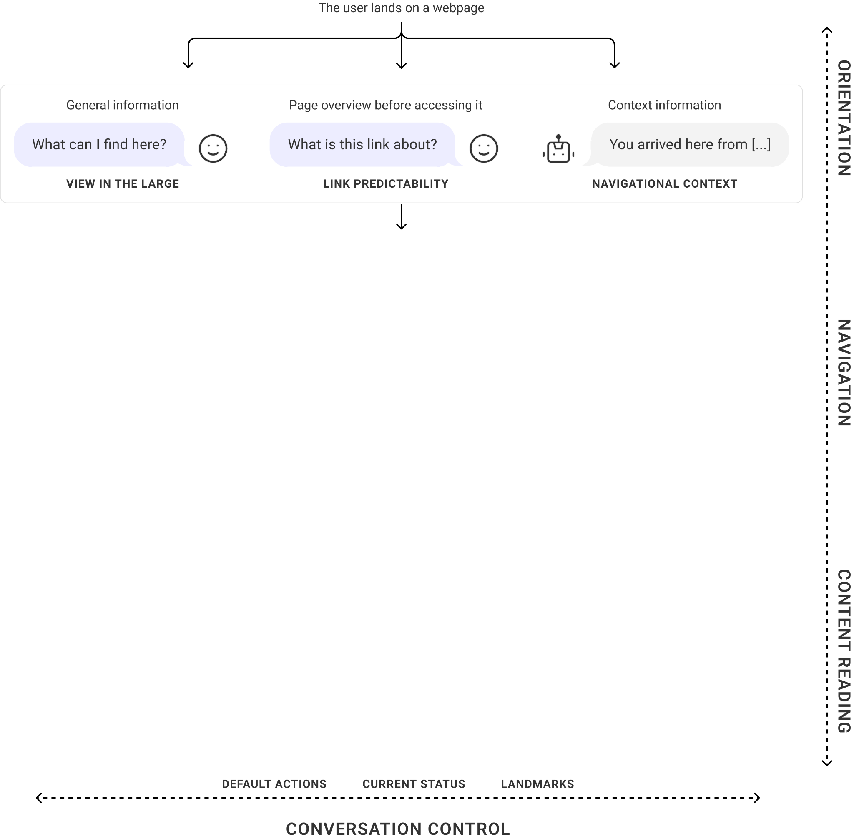
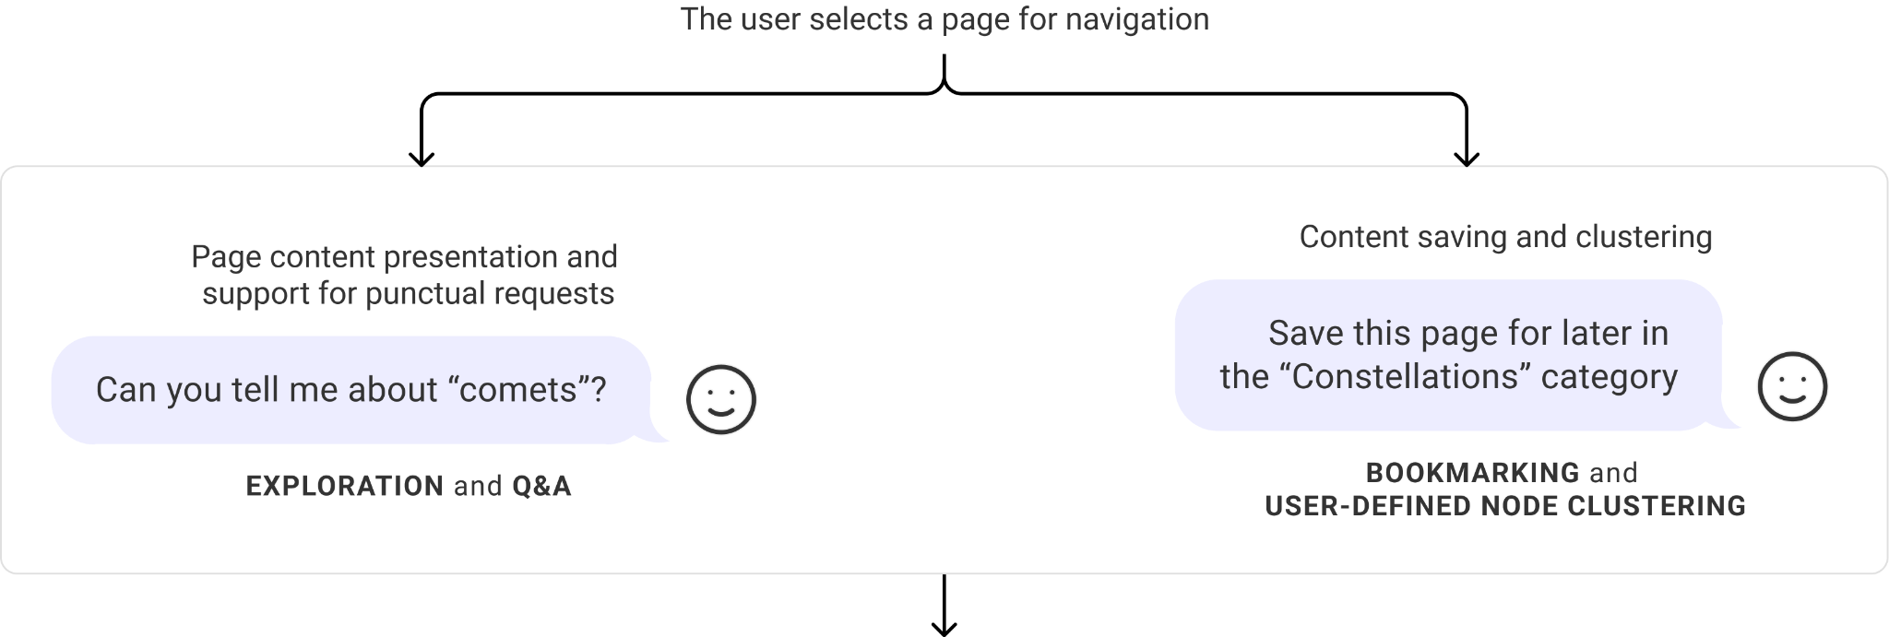
The Patterns in action
Notes:
The study helped us identify challenge in navigation and their solutions, the patterns. Here you can see the different design dimensions and their relative patterns along the browsing experience, from the Home Page landing up to the content fruition.
The users can ask for general information as soon as they land on a page, specific information while navigating, and perform different operation such as saving pieces of information while browsing. The conversational control dimension, instead, offers them default browsing commands.

Slide 12
Preliminary Validation
Navigation
Overall Performance and Experience
Orientation
Content reading
“Asking directly for a topic is an impressive option and represents one of the best features for me”
“Controlling the Website with my voice it’s amazing!”
“It helps me create a model of the website's organization without accessing any piece of content.”
“[...] I like that ConWeb is not “choosing for me”, but rather makes it clear what I am selecting and which paragraphs I can listen to later.”
Notes:
We implemented ConWeb into a technical architecture and ran a preliminary validation where participants were assigned with various browsing tasks, gathering qualitative insights about different dimensions. To recap the results,

Slide 13
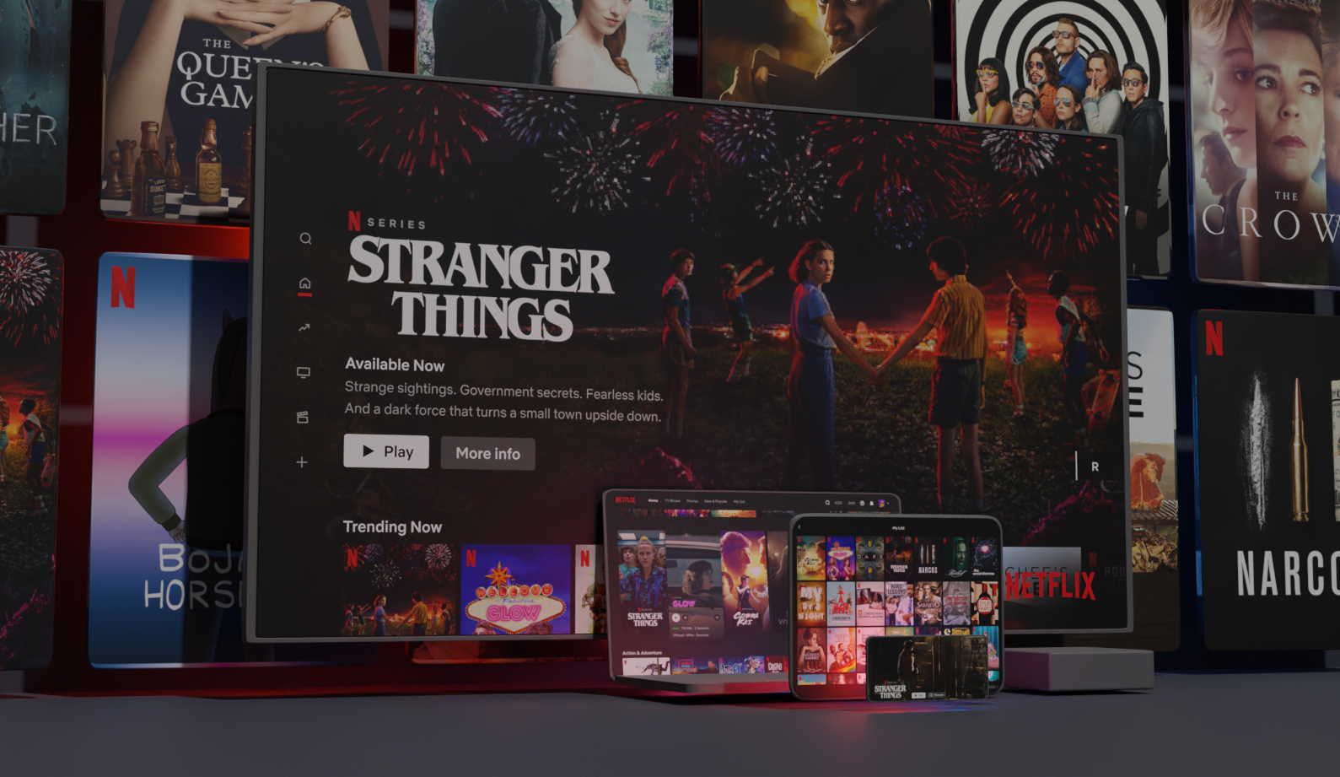
The Web is still a visual experience
Notes:
The web is still, indeed, a visual experience. We can

Slide 14
Methodology
The adopted human-centered process
Notes:
To understand how to do this, we adopted a human-centered process.

Slide 15
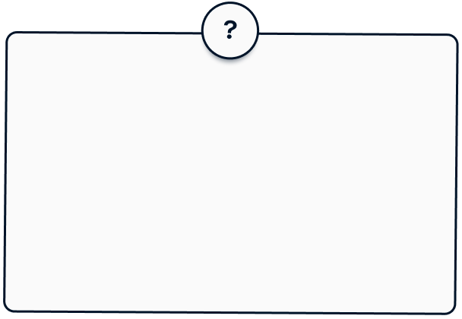
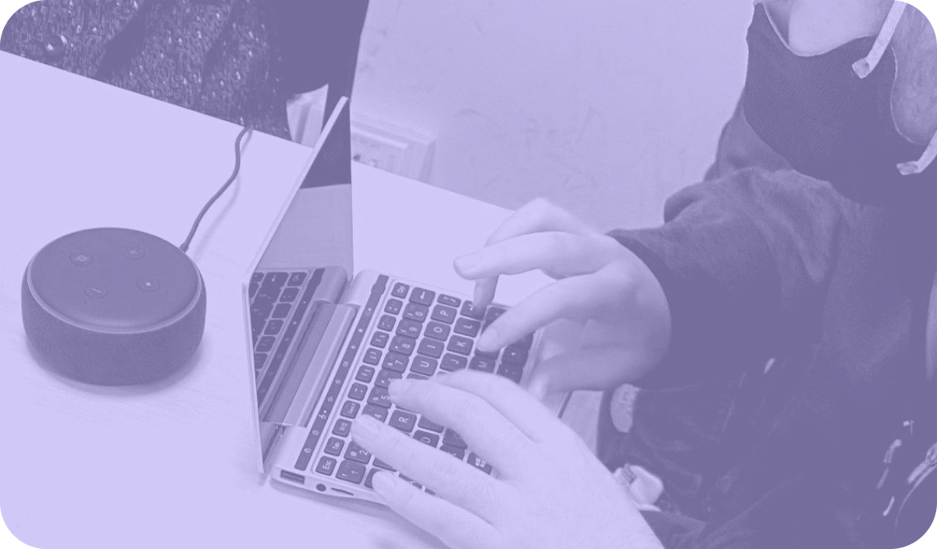
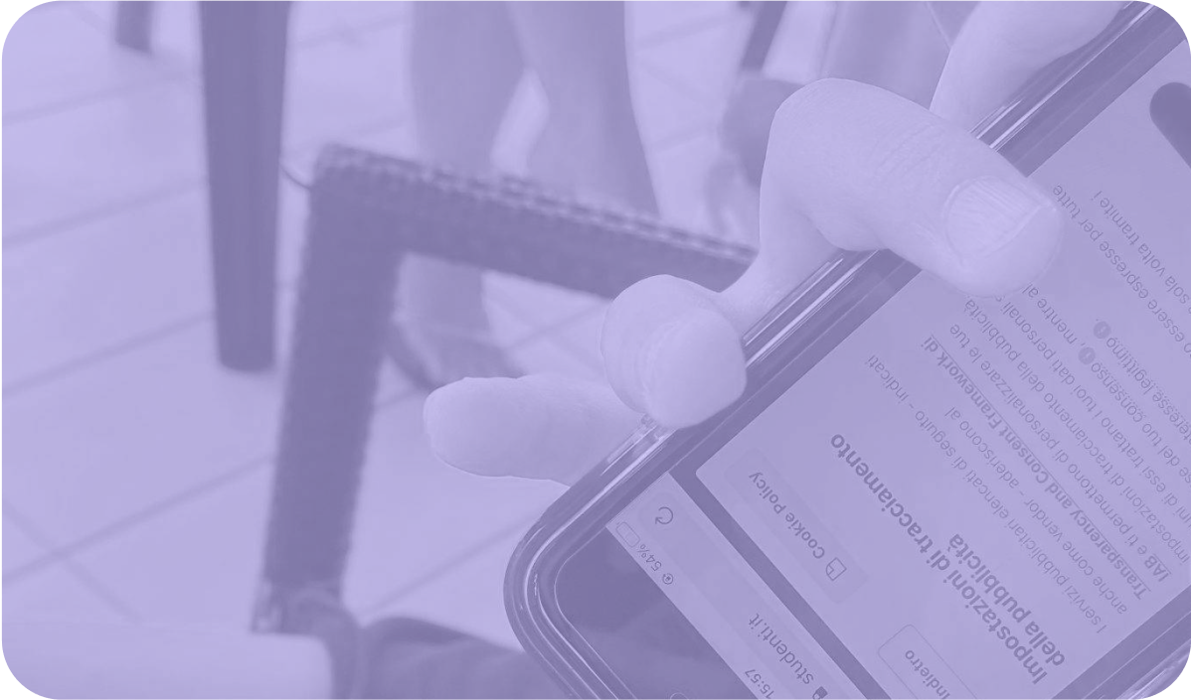
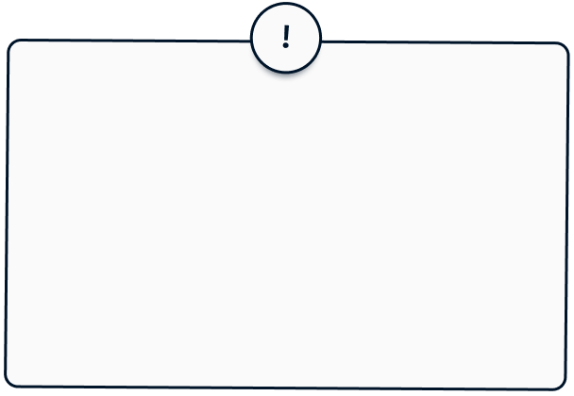
THE WHY: Research Questions
How do we design effective conversational access to the Web?
How can we turn Web pages into dialogs with a user?
Identification of design patterns and guidelines, and empirical evidence of the impact of this new paradigm
Concepts, techniques, algorithms to integrate Conversational AI with Web architectures
Understand people, their characteristics, needs and behaviors
Collaborative design
activities
Notes:
Two were the main questions:
How do we design effective conversational access to the web? Which required the identification of design patterns, guidelines and empirical evidence, and
How can we turn Web pages into dialogues with a user? Which requires technical concepts and architecture
In this presentation I will focus on the first question, you can find on the paper more details on the technical solution.

Slide 16
Interview with experts, questionnaires and follow-up interviews with participants
Aspects investigated
Preliminary Challenges
Lack of accessibility
Difficult orientation
Unclear link semantics
Experience with Web browsing
Complex memorisation of website structure
High variability of the content organization
Forced by “trial and error”
Problems with navigational context identification
Difficulties in serial reading
Extreme reliance on visual order of page elements
Experience with screen readers
Misleading or partial information acquisition
Lack of natural conversation
Unreliable management of misunderstandings
Lack of feedback when performing tasks
Experience with CAs
Notes:
The first part of the study helped us define browsing behaviours and needs, what we called preliminary challenges.
We started with interview with experts users, addressing three main pillars: the user experience with web browsing, with screen readers and with conversational agents. The first insights were deepened through questionnaires and follow-up interviews up to the elicitation of the “preliminary challenges” you see on the right.

Slide 17
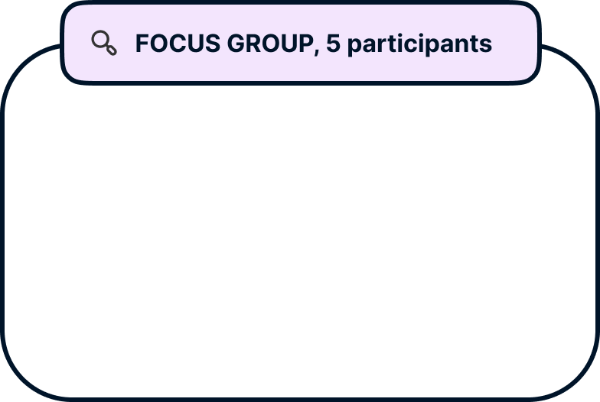
Focus group and co-design sessions
Participants were observed while i) browsing with screen readers ii) browsing with CAs purposely designed
Participants were asked to design a CA on their own, based on their needs and preferences, without considering any technical feasibility problem
+
=
Notes and post-experience considerations were transcribed and extended
to conduct a deductive thematic analysis.
Notes:
A focus group followed up, where participants were observed while i) browsing with screen readers ii) browsing with conversational agents purposely designed by following the insights of the previous phases.
Then a Co-design session was run, and participants were asked to design a conversational agents on their own, based on their needs and preferences, without considering any technical feasibility problem.
We then defined patterns for conversational browsing by performing a deductive thematic analysis from the gathered material.

Slide 18
ConWeb
The Patterns
Exploring solutions to the challenges identified
through the user-centred research
Notes:
This helped us identified 4 design dimensions and their patterns.
The dimensions follow the users along the entire navigational path, from when the landing to the digestion of content.

Slide 19
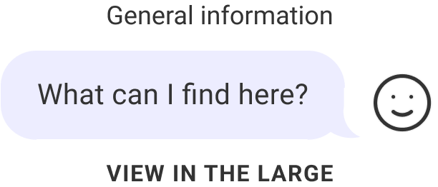
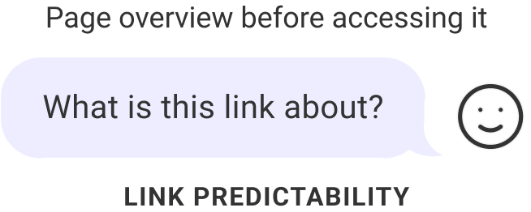
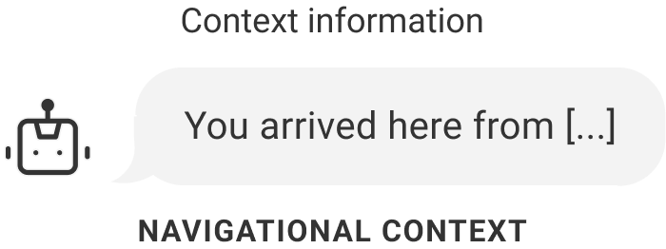
Orientation: Helping the user understand the website and information structure
View in the large. The CA presents the user with the main section and content navigable on the web site.
Link predictability. The CA informs the users about a link’s content before they navigate to that specific link.
Navigational context. The CA acts as a sort of breadcrumb, informing the user on navigation history.
Notes:
First, when the users land on a webpage they want the Conversational Agents to help them recall the information structure of the same webpage, so it should present the user with the main section and content navigable on the web site.
Then, they want to be able to have information about a certain link to understand whether the information contained on that link is relevant for their research. Without a visual support is indeed a costly operation to open a new webpage and understand if its content is useful.
Finally, the users want the conversational agents to inform them about the navigational history, acting as a sort of breadcrumb.

Slide 20
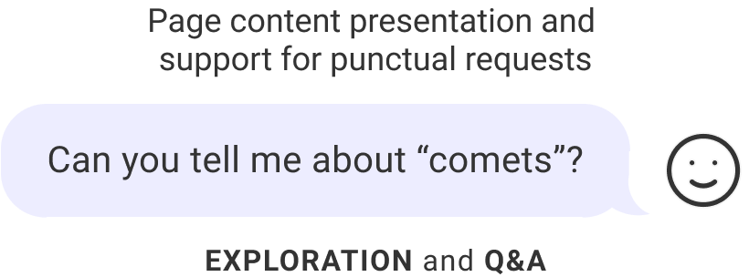
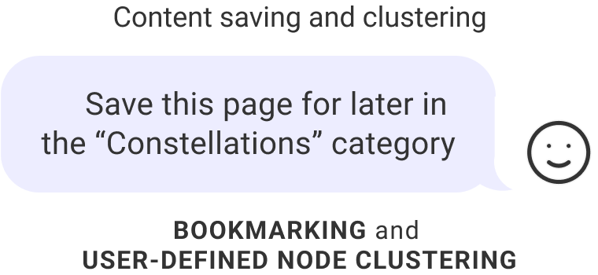
Navigation: Helping the user move across a Web site
Exploration of thematic areas. The CA lets the user move horizontally across pages or vertically within a page.
Q&A. The user can ask direct questions on a certain argument (present on the website) and receive a punctual answer.
Bookmarking and node clustering. The user can decide to save information (nodes) as bookmark and access it later, and organize the same information stored in clusters.
Notes:
Once the users oriented themselves, it is very likely that they will want to navigate the content.
It is important to let them move not only sequentially (as a screen reader would do), yet also vertically (digging down a specific topic) or horizontally (moving across different topics).
During the co-design sessions the participants also expressed the need to be able to access information directly through Q&A,
together with the opportunity to “save” pieces of information and being able to access them on-demand in future sessions (sort of bookmarks, yet for specific pieces of content).

Slide 21
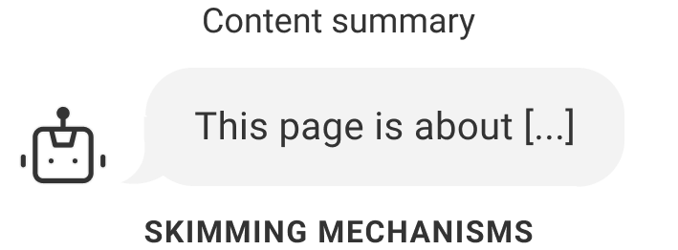
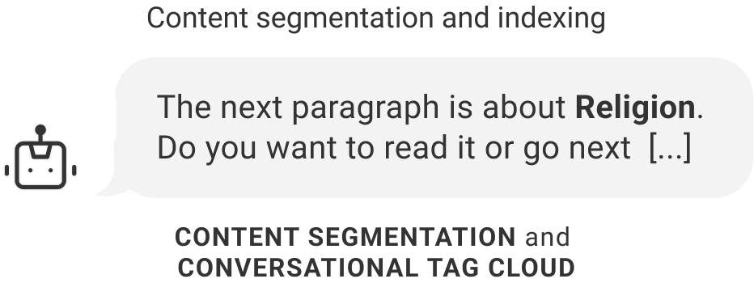
Content Reading: Helping the user consume content
Skimming Mechanisms. The CA is in charge of transforming piece of information in order to make it digestible for the user (e.g. summarization techniques).
Content Segmentation. The CA automatically recognizes block of content (e.g. paragraphs) and lets the user easily move across them.
Conversational tag cloud. The CA can aggregate information in cluster and present it to the user in a conversational mode.
Notes:
Finally the user would like to be supported in digesting content. The Content-reading dimension is about that: how can we deliver content into a conversation-likely form?
First, we identified the opportunity for a segmentation of content (especially verbose ones) in order to let the user jump from segment to segment.
While accessing long pieces of content, the user would also receive a brief overview over them.
Finally, the users highlighted the need for clustering content into main topics, a sort of tag cloud that can then be navigated and explored by conversation.

Slide 22
Conversation Control: Providing access to conversation-scaffolding intents
Default actions. Pre-defined set of commands for basic actions (e.g., back, forth, help)
Current Status. Informing the user on navigation history and content current location to enhance navigational and content-reading patterns.
Landmark nodes. Identifying pillar contents (such as those in the Home Page and in nodes representing main thematic areas) and enabling the user to easily reach them at any step of the conversation.
Notes:
The study also highlighted a type of operations which follow the user along the entire navigation, as default navigation actions (such as back, forth, etc.) or the request to get back to the home page.

Slide 23
ConWeb
Conclusions
Our conclusions and next steps

Slide 24
Conclusions
New Interaction Paradigm for Browsing the Web with its patterns.
Perception of Participants. More natural interaction and reduced cognitive effort.
Conversational Web for all. The pattern might be extended to other type of impairments and situations.
Customization for specific needs. Need for a wider spectrum of voice-based solutions, with high level of control and configurability.
Supporting Prompt-Interaction through Patterns for Conversational Web
Notes:
It emerged that participants found the interaction with ConWeb natural and perceived a reduced cognitive effort.
There were also aspects that need to be further investigated, as the possibility to extend the framework to other types of impairment and situations in which the visual channel cannot be leveraged (like when driving for example) and introducing customization mechanisms.
Yet, during the last months emerged also the possibility to use patterns to support prompt-interaction for conversational web, and we want to investigate also this line of research.

Slide 25
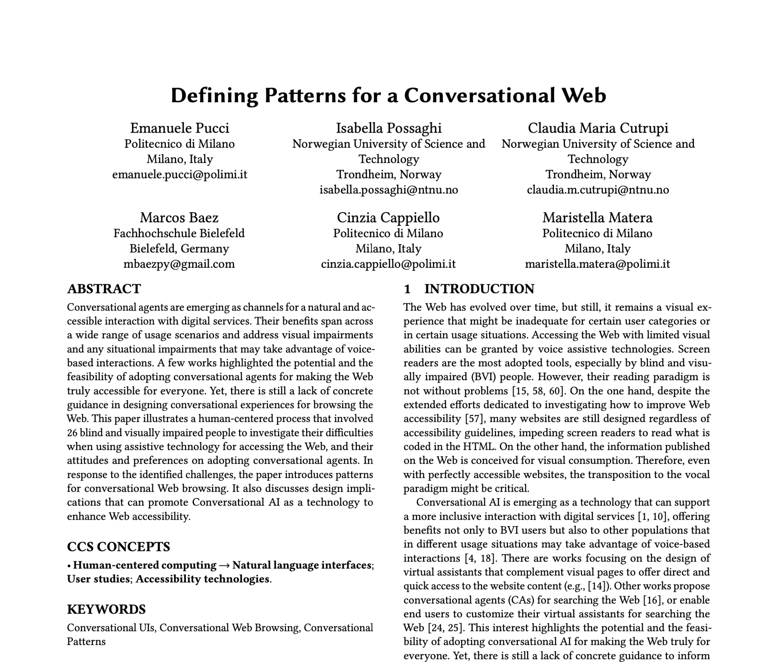
Thank you!
For more details on our research, please, refer to our paper!
contact us at: emanuele.pucci@polimi.it
Notes:
With this, I wanted to thank you all for the attention and invite you to contact us to ask questions

Slide 26
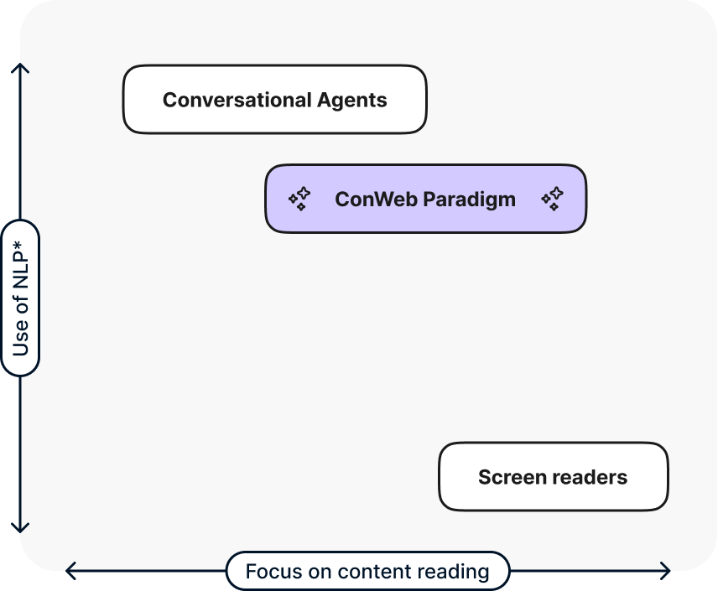
THE VISION – Towards the Conversational Web
Positioning
Notes:
This new paradigm wants to position itself between screen readers and conversational agents. The project started indeed as an assistive technology to help blind and visually impaired people browse the web, but it revealed potentially useful applications in many fields, both for permanent and temporary impairments.

Slide 27
Conversation Control: Providing access to conversation-scaffolding intents
Default actions. Pre-defined set of commands for basic actions (e.g., back, forth, help)
Current Status. Informing the user on navigation history and content current location to enhance navigational and content-reading patterns.
Landmark nodes. Identifying pillar contents (such as those in the Home Page and in nodes representing main thematic areas) and enabling the user to easily reach them at any step of the conversation.
Notes:
The study also highlighted a type of operations which follow the user along the entire navigation, as default navigation actions (such as back, forth, etc.) or the request to get back to the home page.

Slide 28
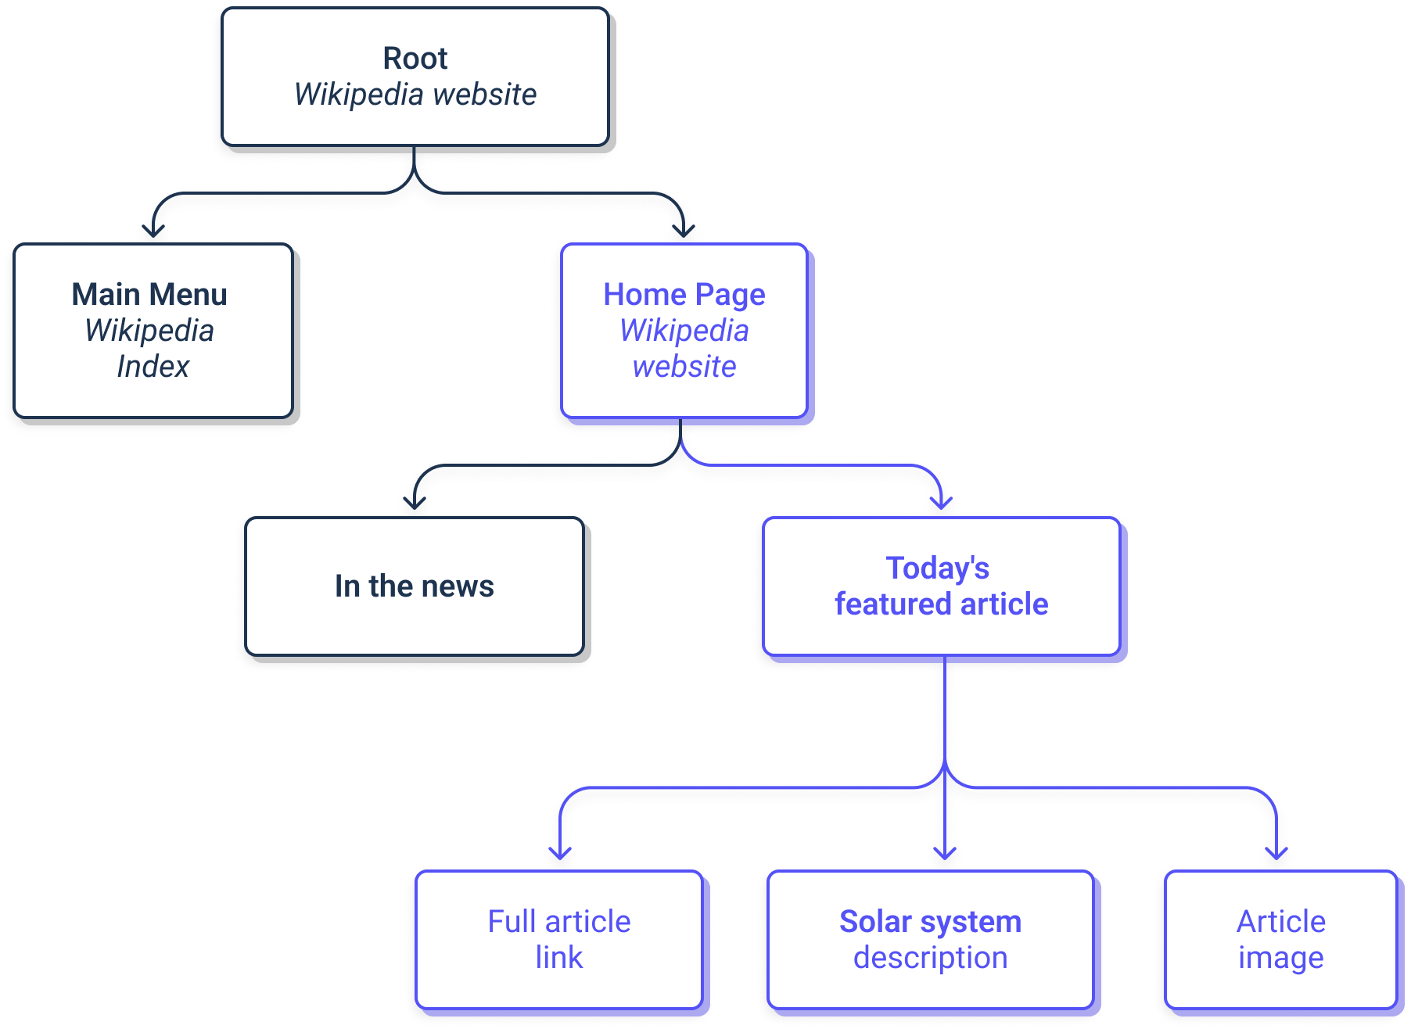
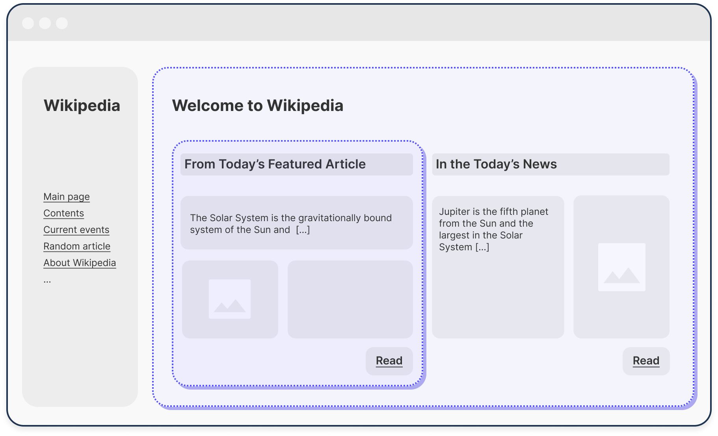
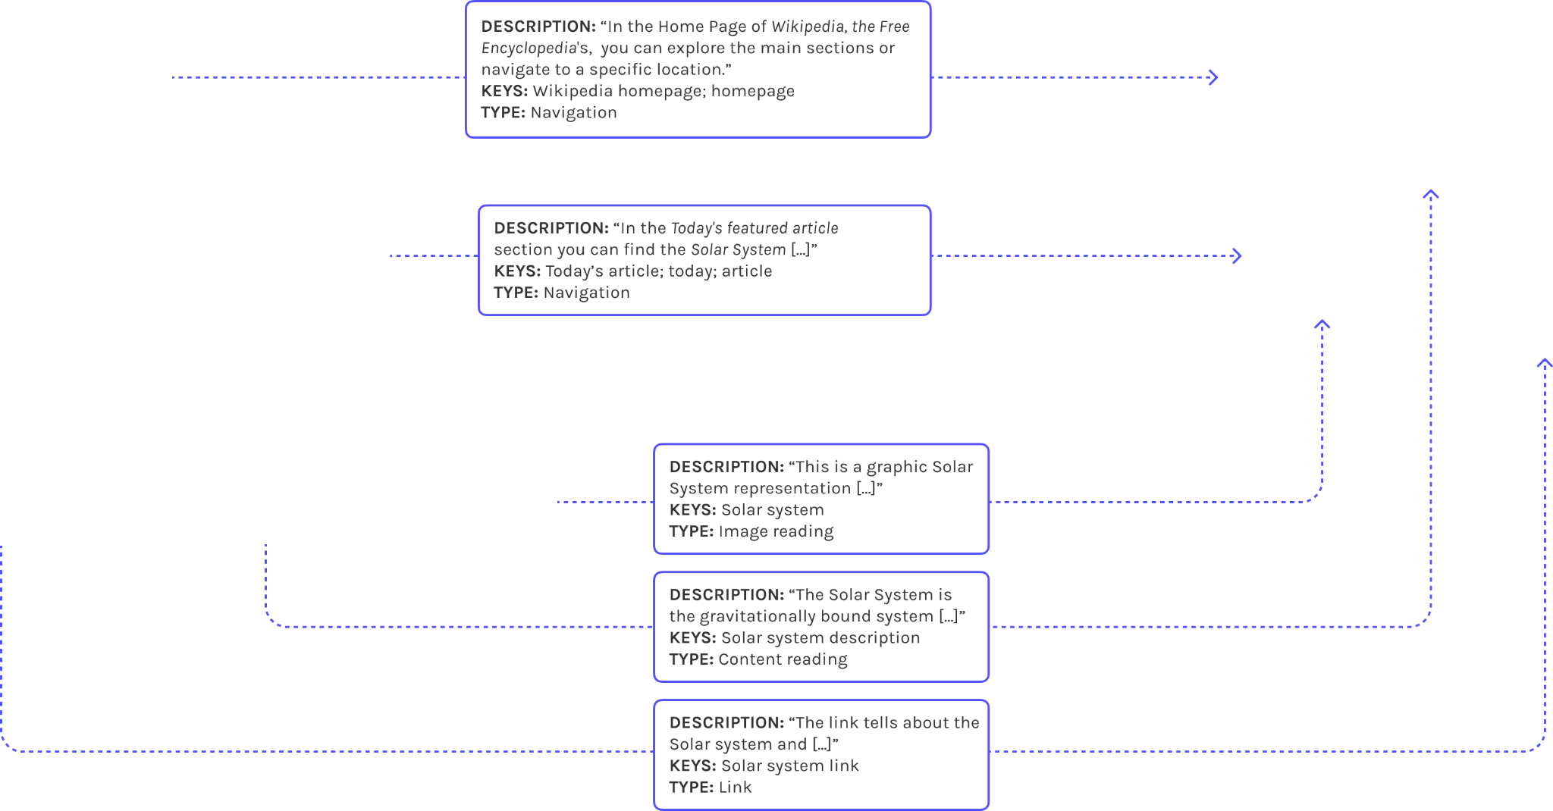
CNT (Conversation-oriented Navigational Tree)
Notes:
We implemented the patterns into ConWeb, which is a technical framework relying on what we called Conversation-oriented Navigational Tree to organize the web page information into conversation.
For each page in a website the CNT represents a hierarchical nesting of both content elements and navigational structures, which recalls the HTML DOM organization but introduces new conversation-oriented elements.
***Each node in the tree, which we call conversational node, can be a content paragraph, a navigation menu, a link, or any other element in the webpage that can be presented independently of the others and has a role in the exploration of the website content.
Each node is associated with descriptions, which can be already available in the HTML code (e.g., alt-text for images), or purposely generated to enable the conversation, for example by means of indexing and summarization techniques.***

Slide 29
Conclusions
Limitations
Aspects to be tackled in future studies
Patterns coverage. Current focus on information-oriented well-structured Websites to clearly identify possible patterns. Future studies must address the management of dynamic components and other classes of Websites (e.g., transactional).
CNT management. Automatic tag generation, although already present, must be improved and tested with dynamic Websites.
Diversity of study participants and sample size. Future studies will gather a higher number of participants and a more diverse sample.
Notes:
We want to acknowledge the limited coverage of pattern to static and well-organized websites such as wikipedia, future studies will need to test the framework also on more complex websites. Also the diversity of study participants and the sample size will be enlarged with new and large-scale studies, with a balanced involvement of participants based on their diverse characteristics.
To consolidate this strategy, we are planning new and large-scale studies, with a balanced involvement of participants based on their diverse characteristics.

