Slide 1
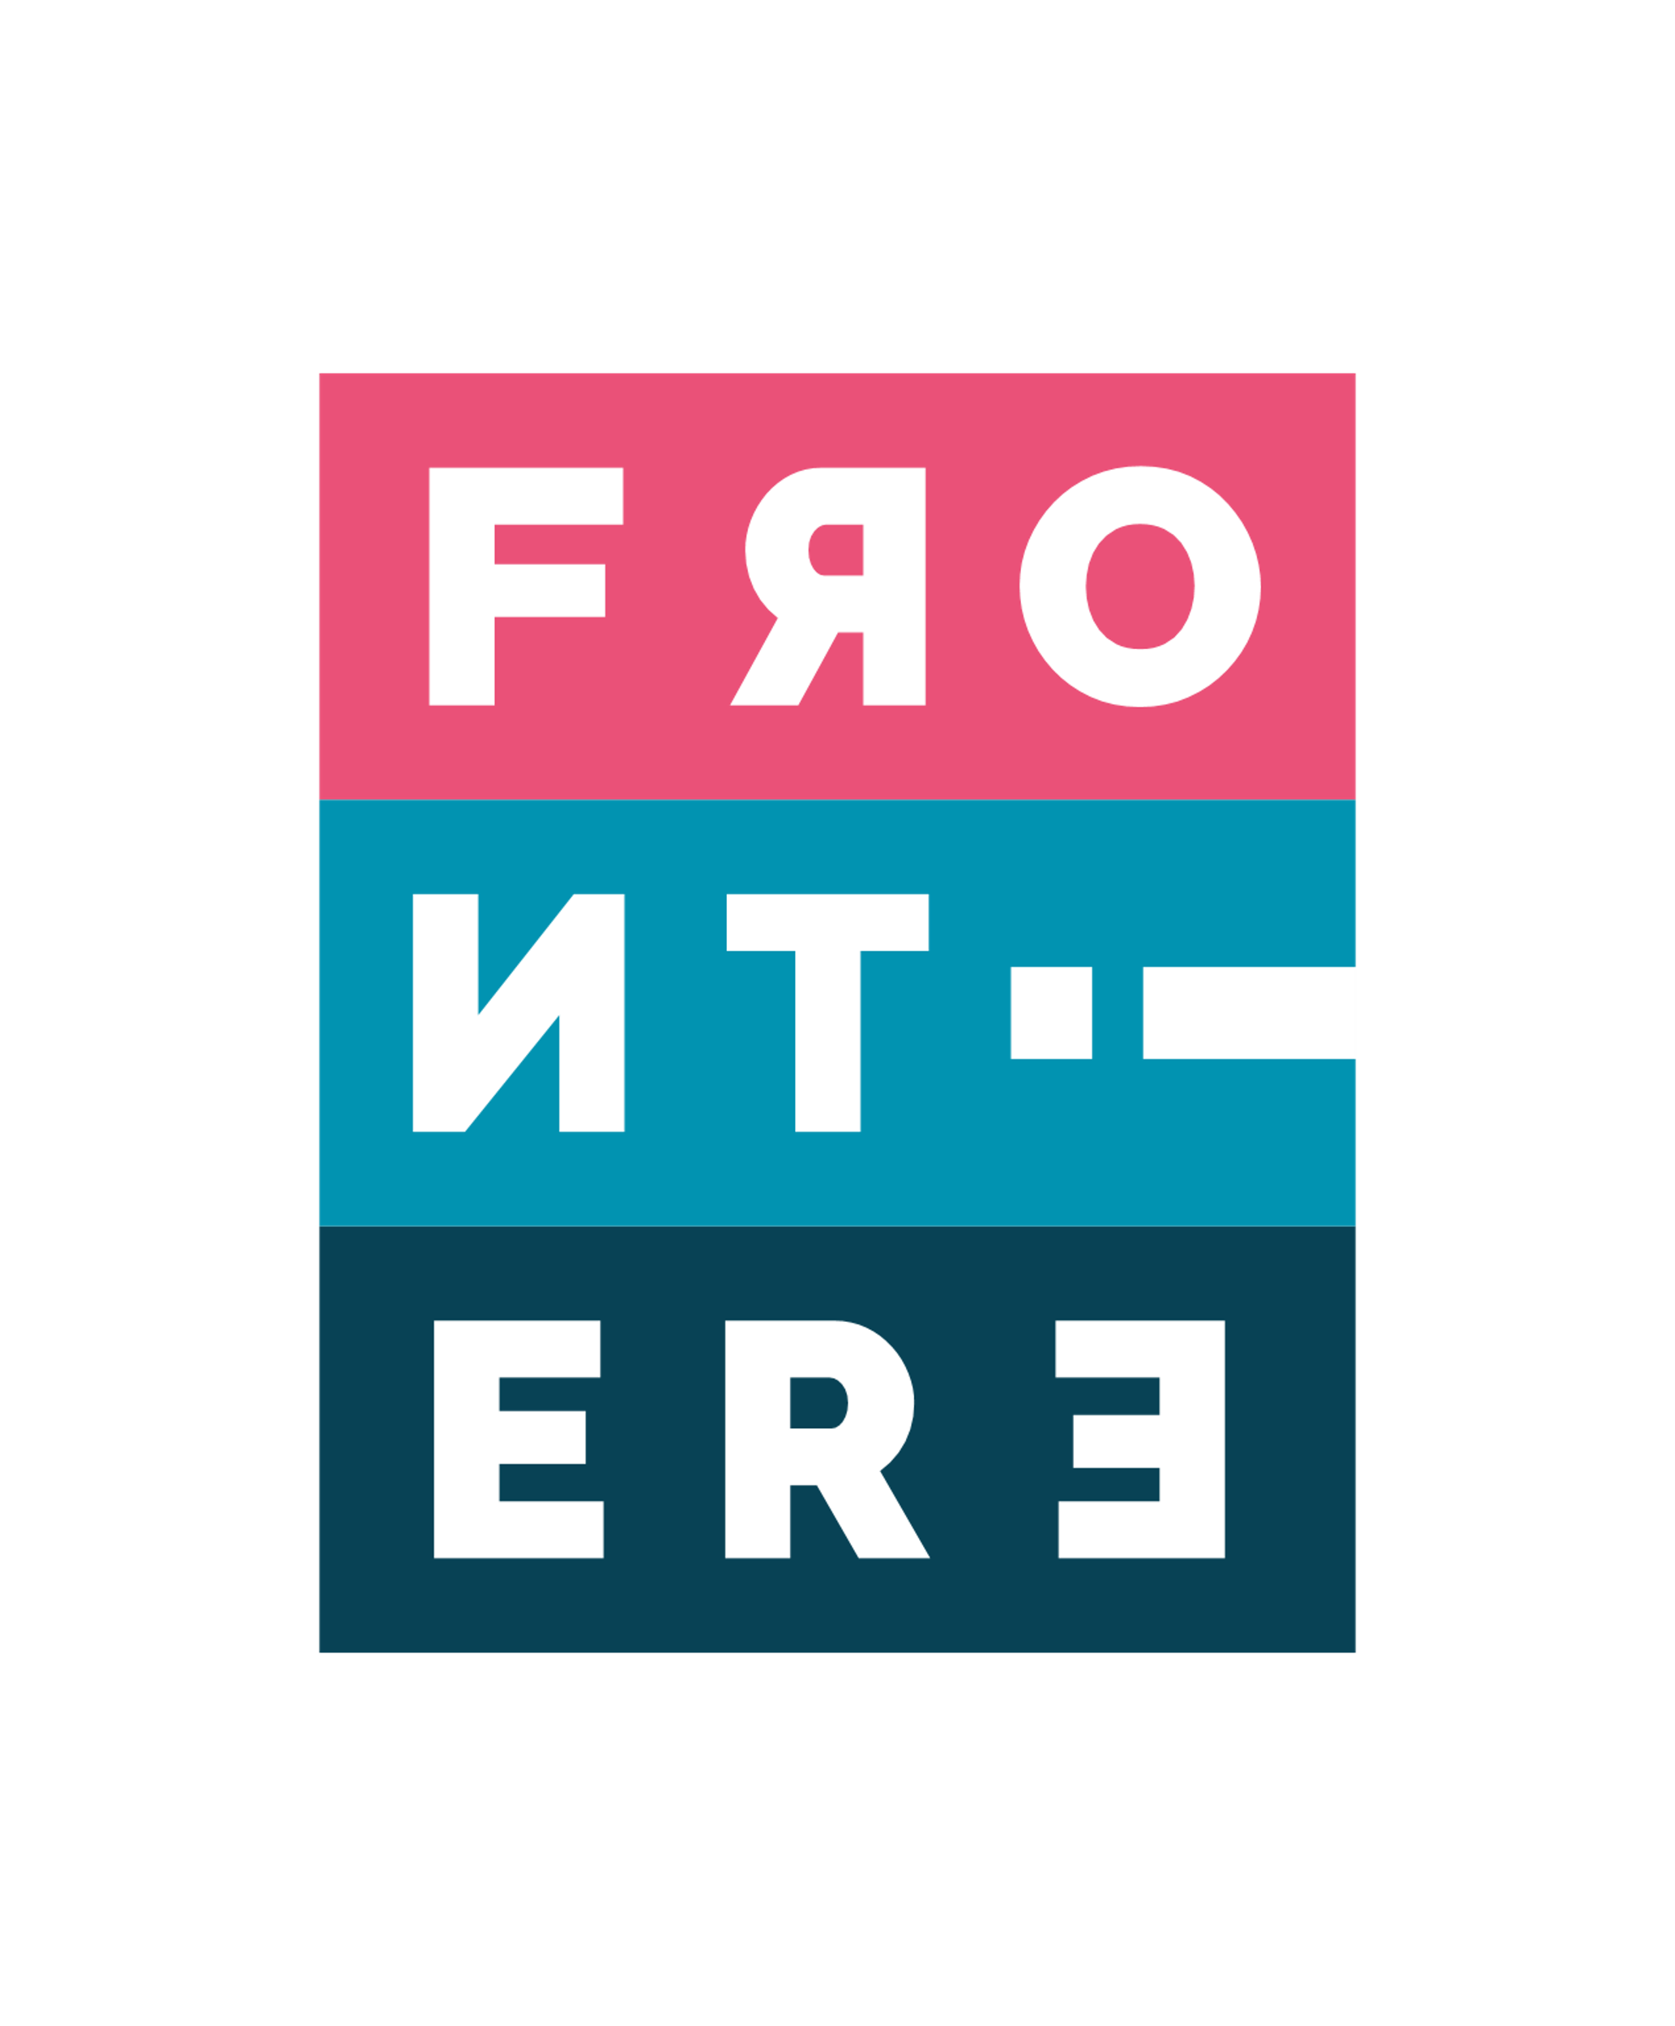
FRONTIERE
Innovation, Technology, Consulting
AI poWered cancer predIction, diagnosis and treatmeNt
Pisa, 30 May 2023

Slide 2
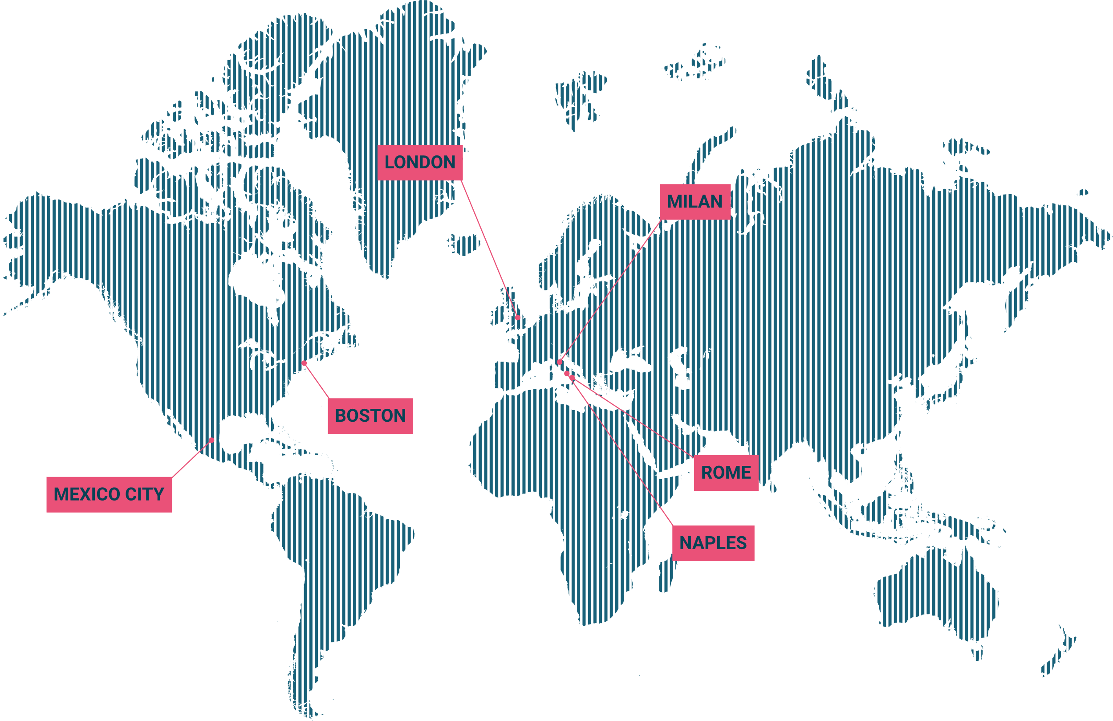
Who we are
With more than 10 certified Innovation Managers, as well as entrepreneurs and professionals who are experts in innovative technologies, Frontiere offers the skills needed to accompany businesses into the Digital Transformation era.
New Humanism, Sustainability, and Accessibility are our founding elements.
The human being is at the center of our idea of Innovation: we constantly evaluate the impact of new technologies on the environment and people, to ensure sustainable progress and a better user experience by combining aesthetic and design elements typical of Made in Italy.

Slide 3
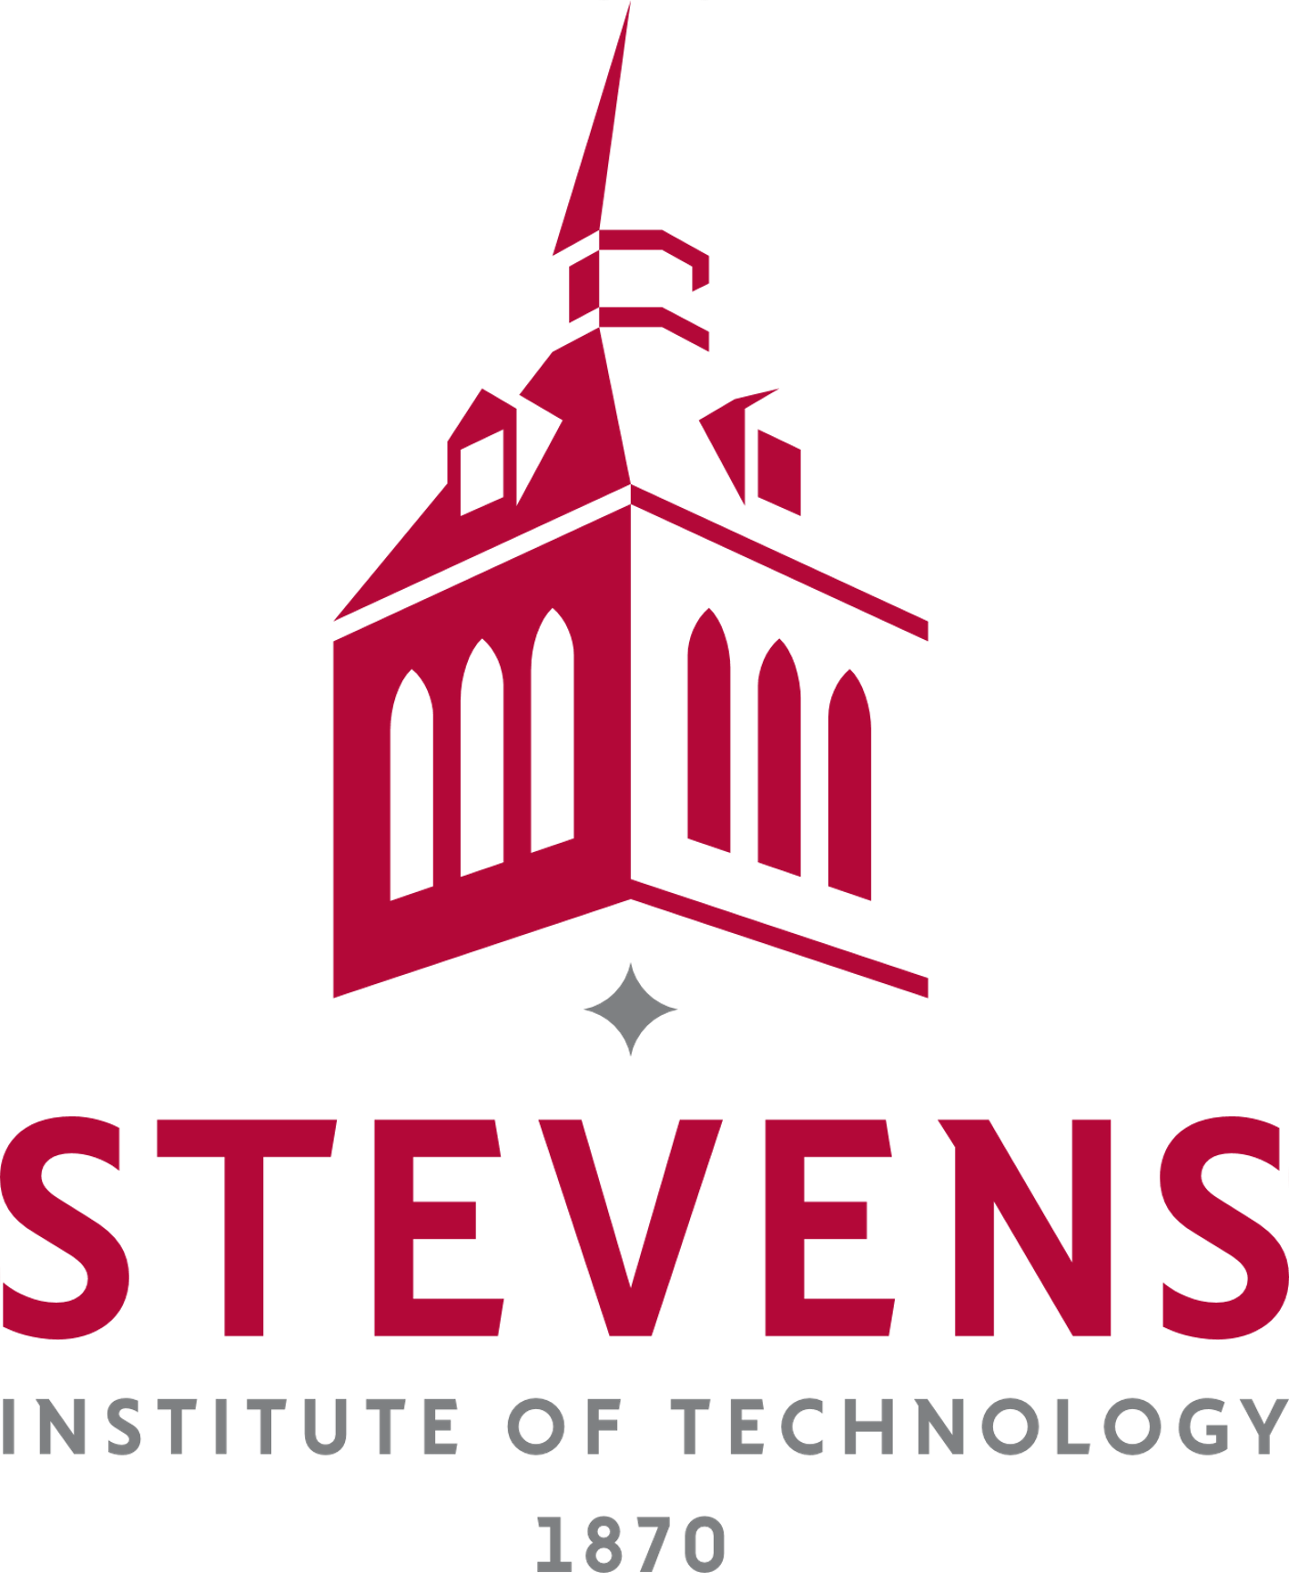
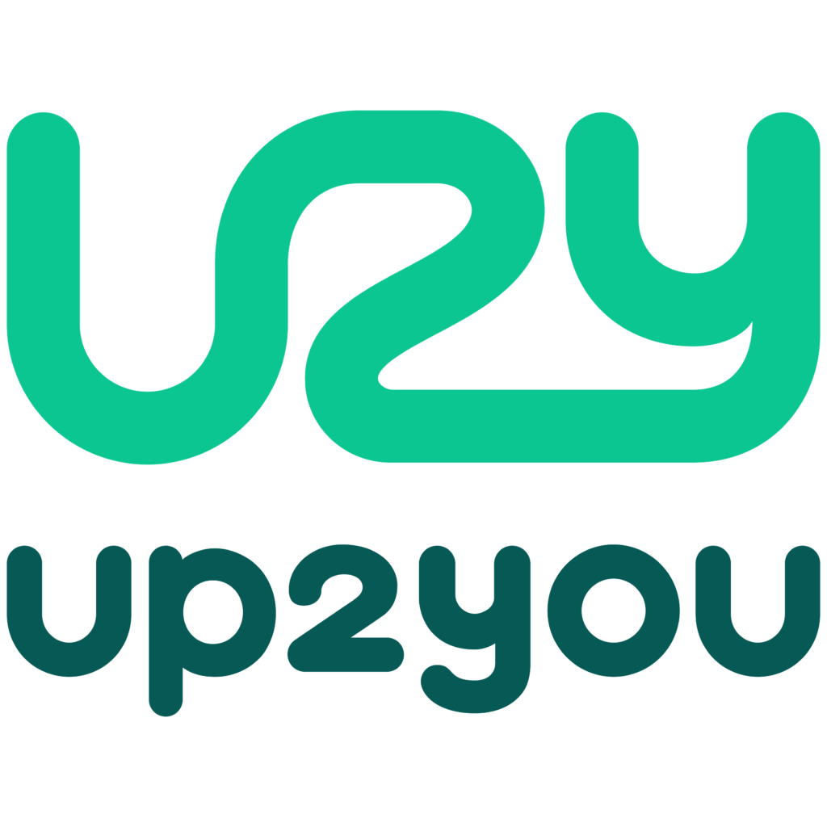
Open Innovation Ready to Go

Slide 4
Scenario
Key in cancer care: early diagnosis, prediction. Prevent metastasis, improve survival, cost-effective treatments. Reduce mortality, enhance outcomes.
Medical imaging speeds up cancer diagnosis and guides personalized treatment decisions. Early detection, prognosis, and disease assessment rely on imaging findings. Essential for informed treatment choices.
Adoption
AI enhances prediction, diagnosis, and treatment accuracy in cancer care.
Large amounts of medical images enable the development and training of advanced AI algorithms.
AI can predict cancer development and establish rapid and precise diagnoses.
AI analyzes cancer-related datasets to determine optimal treatments for individual patients.
AI has the potential to forecast clinical endpoints like complete clinical response and survival.
AI democratizes healthcare, improving access and lowering costs.
AI relieves overworked doctors and reduces the risk of medical errors.
Notes:
La diagnostica per immagini medica accelera la diagnosi del cancro e orienta le decisioni di trattamento personalizzate. La rilevazione precoce, la prognosi e la valutazione della malattia si basano sulle immagini diagnostiche. Sono fondamentali per scelte di trattamento informate.
L'intelligenza artificiale migliora la capacità di previsione, diagnosi e precisione del trattamento nella cura del cancro. Grandi quantità di immagini mediche consentono lo sviluppo e l'addestramento di algoritmi avanzati di intelligenza artificiale. L'intelligenza artificiale può prevedere lo sviluppo del cancro e stabilire diagnosi rapide e precise. L'intelligenza artificiale analizza set di dati correlati al cancro per determinare trattamenti ottimali per singoli pazienti. L'intelligenza artificiale ha il potenziale per prevedere esiti clinici come risposta clinica completa e sopravvivenza. L'intelligenza artificiale democratizza l'assistenza sanitaria, migliorando l'accesso e riducendo i costi. L'intelligenza artificiale allevia i medici sovraccarichi di lavoro e riduce il rischio di errori medici.

Slide 5
Challenges
Two main challenges are observed in acquiring the necessary training data for DL-based AI and medical image analysis:
Gaining access to medical archives, which are located in closed proprietary databases within hospitals. Privacy regulations impede the distribution and access to these data.
Obtaining validated and annotated image data systematically, considering factors such as the actual data values, heterogeneity of data sources, and provision of data labelling
Notes:
Due principali sfide si riscontrano nell'acquisizione dei dati di addestramento necessari per l'intelligenza artificiale basata su deep learning e l'analisi delle immagini mediche:
Ottenere accesso agli archivi medici, che si trovano in database proprietari chiusi all'interno degli ospedali. Le normative sulla privacy ostacolano la distribuzione e l'accesso a questi dati.
Ottenere dati di immagini validati e annotati in modo sistematico, considerando fattori come i valori effettivi dei dati, l'eterogeneità delle fonti di dati e la fornitura di etichettatura dei dati.

Slide 6
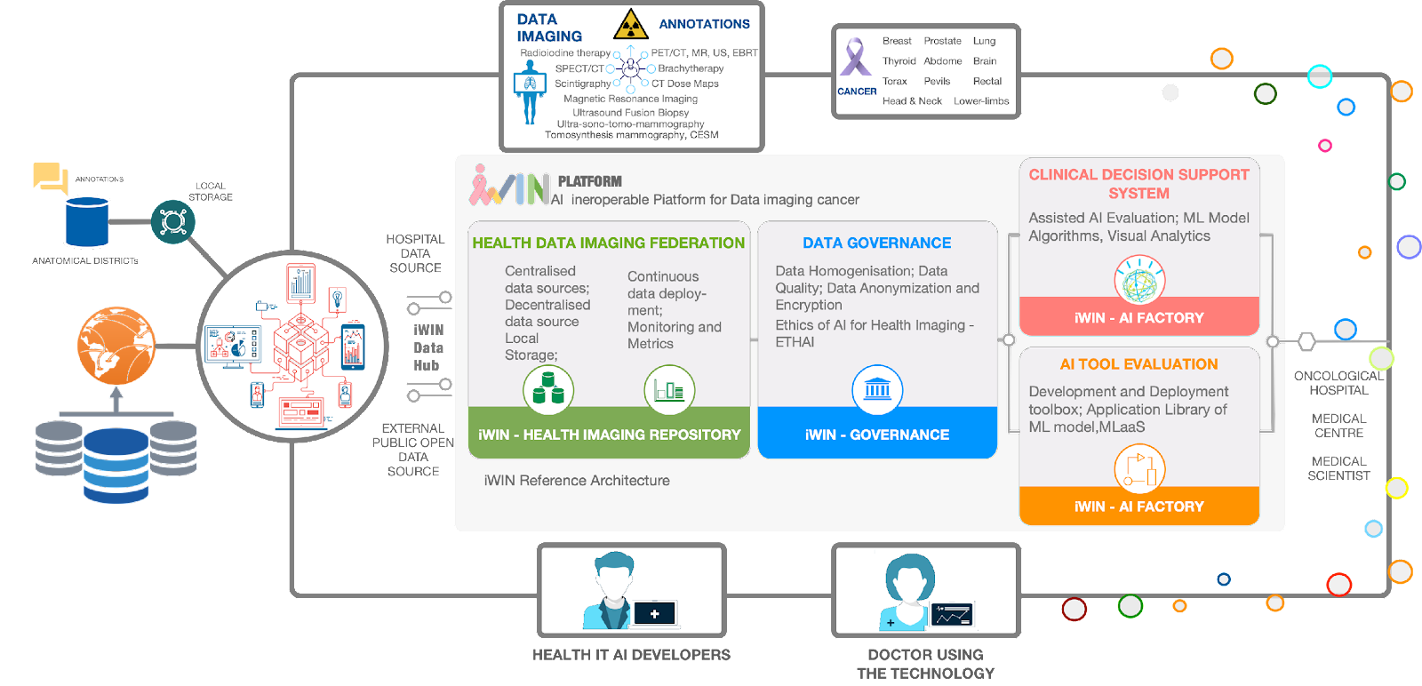
Decision Support System: Concept
Notes:
In today's rapidly evolving technological landscape, the integration of the connected world and artificial intelligence (AI) holds immense potential for achieving smart sustainability. This convergence enables us to harness the power of advanced connectivity and intelligent systems to address environmental challenges, optimize resource utilization, and enhance the overall quality of life. In this presentation, we will explore the transformative impact of the connected world and AI on sustainable development, highlighting key opportunities and challenges.
The Connected World: Enabling Sustainable Solutions
Overview of the connected world concept and its significance in the context of sustainability.
Exploring the Internet of Things (IoT) and its role in creating a network of interconnected devices and systems.
Leveraging IoT for real-time data collection, analysis, and monitoring to enable informed decision-making and resource optimization.
Case studies illustrating the application of the connected world in smart cities, smart agriculture, energy management, and waste reduction.
Artificial Intelligence: Empowering Smart Sustainability
Introduction to artificial intelligence and its various components, including machine learning, deep learning, and natural language processing.
How AI algorithms and models can analyze vast amounts of data to derive valuable insights for sustainable development.
Utilizing AI for predictive analytics, anomaly detection, and optimization in energy efficiency, transportation, and environmental conservation.
Showcasing AI-driven solutions that enhance renewable energy integration, enable intelligent transportation systems, and support eco-friendly practices.
Synergies and Benefits: Connected World and AI
Exploring the synergistic relationship between the connected world and AI, and their combined potential to drive sustainable outcomes.
Discussing the advantages of AI-enabled connected systems, such as improved efficiency, reduced costs, and enhanced user experiences.
Highlighting success stories where the integration of connectivity and AI has led to significant advancements in sustainable technologies.
Addressing potential challenges related to data privacy, security, ethical considerations, and the digital divide.
Future Perspectives and Opportunities
Discussing emerging trends and technologies that further enhance the role of the connected world and AI in sustainable development.
Examining the role of edge computing, 5G networks, and cloud infrastructure in supporting the scalability and efficiency of connected systems.
Exploring the potential for AI-powered decision support systems and autonomous solutions in optimizing sustainability practices.
Identifying research areas and collaboration opportunities for academia, industry, and policymakers to drive innovation in smart sustainability.
Conclusion: The convergence of the connected world and artificial intelligence presents an unprecedented opportunity to address pressing sustainability challenges. By leveraging advanced connectivity, IoT, and AI technologies, we can build intelligent systems that optimize resource utilization, reduce environmental impact, and create more livable and sustainable communities. Embracing this transformative potential requires collaborative efforts and innovative solutions that prioritize ethical considerations, security, and inclusive access. Together, we can shape a future where technology empowers us to achieve smart sustainability on a global scale.
The Connected World: Enabling Sustainable Solutions
Efficient Resource Management: The Connected World enables real-time monitoring, data collection, and resource usage analysis.
Environmental Impact Mitigation: The Connected World facilitates proactive environmental management through interconnected devices and systems.
Renewable Energy Integration: The Connected World is crucial in integrating renewable energy sources into the grid.
Smart Cities and Infrastructure: The Connected World enables the development of smart cities and intelligent infrastructure.
Data-Driven Decision Making: The Connected World generates vast amounts of data from various sources.
Collaboration and Innovation: The Connected World fosters collaboration and innovation by bringing together stakeholders from different sectors.
Artificial Intelligence: Empowering Smart Sustainability
Sustainable Supply Chain: AI enables transparency and traceability across the supply chain, optimising transportation routes, reducing waste, and promoting ethical and sustainable sourcing.
AI-driven Optimization: Artificial intelligence algorithms analyse complex data patterns and optimise resource utilisation, leading to more sustainable practices and reduced waste.
Smart Cities and Infrastructure: AI-powered systems enhance urban planning, traffic management, waste management, and infrastructure efficiency, creating sustainable and livable cities.
Synergies and Benefits: Connected World and AI
Real-time Monitoring and Control: AI-powered systems in the Connected World enable real-time monitoring and control of various processes and systems, leading to improved efficiency, reduced downtime, and optimized resource utilization.
Seamless Automation: The Connected World, combined with AI, enables seamless automation of tasks and processes, improving productivity, reducing human errors, and freeing up resources for more strategic and sustainable initiatives.
Predictive Maintenance: By leveraging AI algorithms and the connectivity of devices and sensors, predictive maintenance becomes possible, allowing for proactive and timely maintenance actions, minimising disruptions, and extending the lifespan of the equipment.

Slide 7
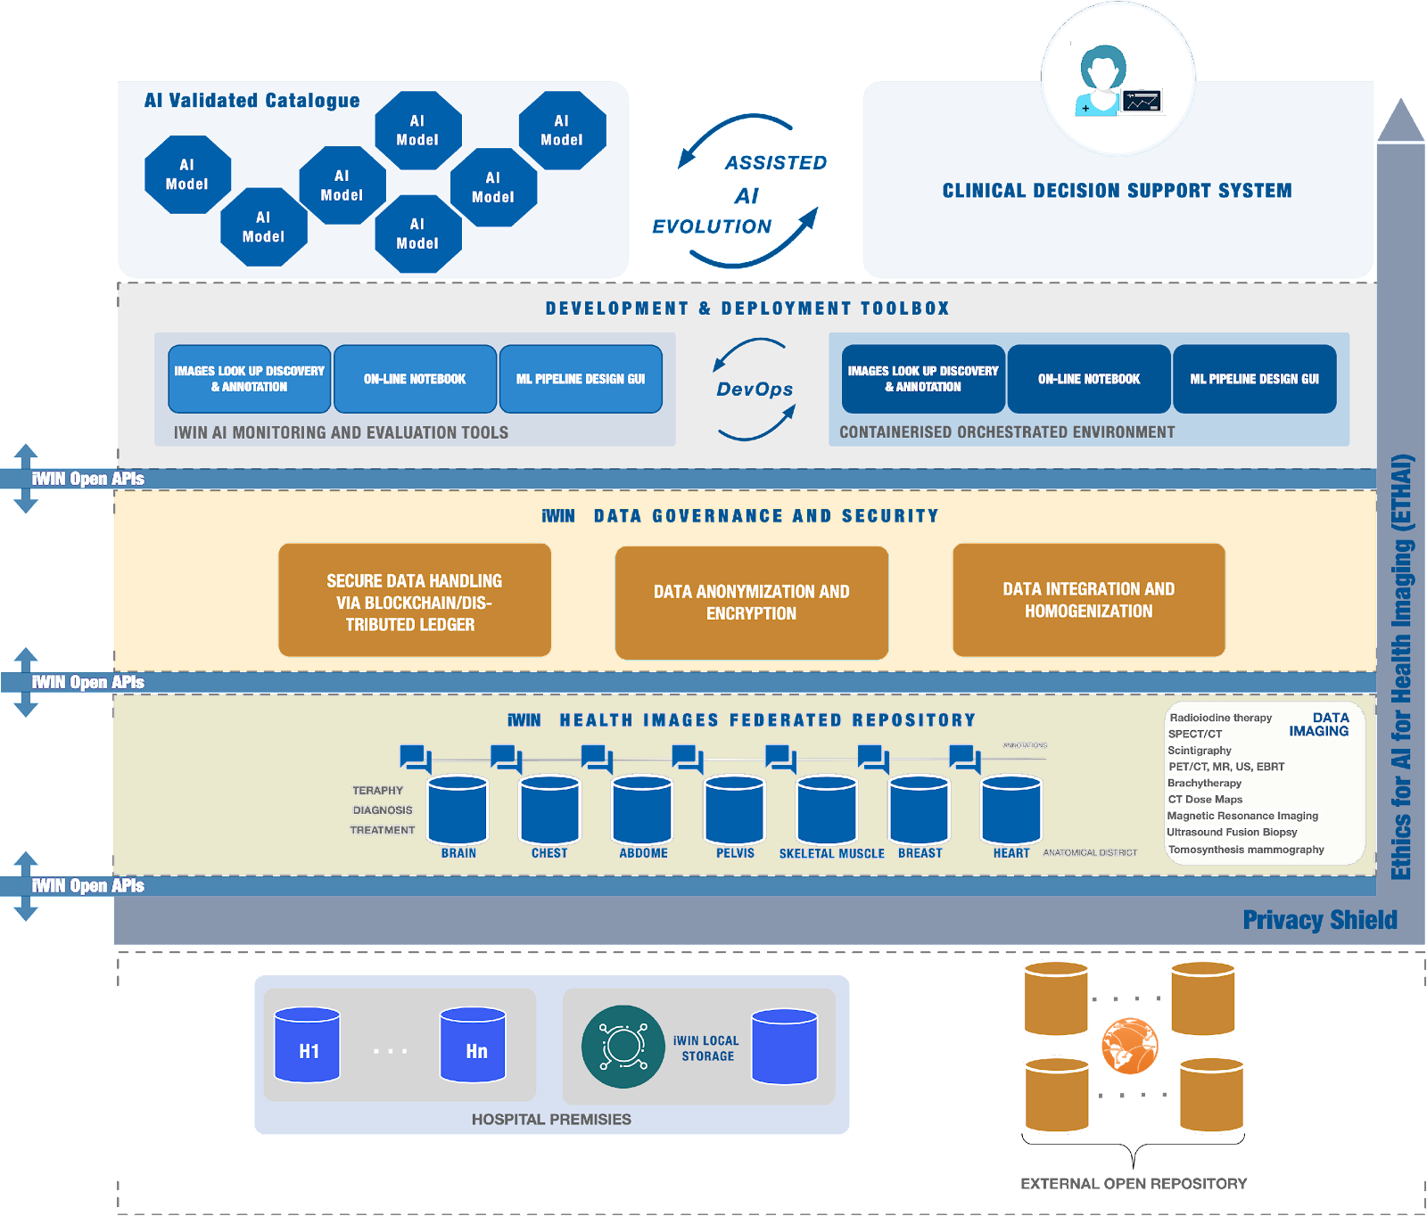
Technical Solution
iWIN approach is considering different options to access and deal with health images data set:
Hospitals can donate health image data sets directly to the iWIN repository while controlling their data even after data shipping. iWIN will support the shipment of data repositories by allowing data providers to create data repositories images and push them into local storage from where they will be available for retrieval or shipment, allowing AI developers to benefit from data sharing securely.
iWIN will be committed to making health image data of External and Public Images Repositories accessible through the iWIN platform.
Notes:
L'approccio iWIN considera diverse opzioni per accedere e gestire i dataset di immagini mediche:
Donazione diretta da parte degli ospedali:
Gli ospedali hanno la possibilità di donare direttamente i loro dataset di immagini mediche al repository iWIN.
Gli ospedali mantengono il controllo dei propri dati anche dopo che sono stati inviati al repository.
iWIN facilita la spedizione dei repository dati consentendo ai fornitori di dati di creare immagini dei dati e di archiviarle localmente.
Queste immagini possono essere recuperate o spedite in modo sicuro, consentendo agli sviluppatori di intelligenza artificiale di beneficiare della condivisione dei dati.

Slide 8
AI-based solution for Use Case
AI in personalized dosimetry: Automatic extraction of body organs from the 3D dose volume
Personalized dosimetry is an advanced method used to provide information about the 3D dose distribution for patients undergoing diagnostic and interventional X-ray examinations such as CT and fluoroscopically guided procedures.
This very time-consuming procedure prohibits personalized dosimetry to be used in everyday clinical practice.
INNOVATION
Novel, sophisticated artificial intelligence, and machine learning algorithms, for example algorithms based on convolutional neural networks, develops to assist in automatic extraction of main radiosensitive organs of the chest from the 3D dose volume.
This approach allows automatic extraction of main radiosensitive organs of the chest needed for the implementation of patient-specific dosimetry

Slide 9
AI-based solution for Use Case
Diagnosis using CT images of head, lung and breast cancers using AI techniques
Computed tomography (CT) is an excellent imaging technique for anatomy and pathology in various clinical areas.
CT can acquire high-resolution, three-dimensional image sets using x-ray beams in the energy range of 80-140 kV.
Dual energy computed tomography (DECT) allows image acquisition at multiple energies, enabling differentiation between different materials.
The AI approach for extracting effective atomic number is sensitive to artifacts, as small changes in the EMI number can result in significant errors.
AI can minimize diagnostic errors during CT image interpretation
INNOVATION
The idea is to develop and train a smart software using the annotated DECT images
Use AI algorithms to maximize the accuracy of lung, breast and prostate cancer differentiation through in the ROIs across annotated CT images.

Slide 10
AI-based solution for Use Case
AI for segmentation of 3D breast images
Gaining access to medical archives, which are located in closed proprietary databases within hospitals. Privacy regulations impede the distribution and access to these data.
Obtaining validated and annotated image data systematically, considering factors such as the actual data values, heterogeneity of data sources, and provision of data labelling
INNOVATION
Realistic breast models can be created using different approaches and information sources.
Algorithms, particularly those based on convolutional neural networks, can be used to segment breast lesions from 3D medical images.
Breast CT, DBT, breast CT, and MRI are examples of medical imaging modalities used for breast lesion segmentation.
These models can also segment breast lesions and create super-resolution computational models.
The feasibility and effectiveness of this approach require further exploration and study by researchers.
Large databases of images are necessary to observe, model, validate, and evaluate breast lesions.

Slide 11
Conclusion and next steps
Challenges in acquiring training data for AI-based medical image analysis:
Limited access to medical archives due to privacy regulations.
Difficulty in obtaining validated and annotated image data systematically.
Ethics and potential of AI in health imaging:
International scientific debate on the ethics of AI in imaging.
AI has the potential to increase efficiency and accuracy in health imaging.
These challenges and ethical considerations highlight the need for further research and collaboration in the field of AI-based medical image analysis.

Slide 12
FRONTIERE
Innovation, Technology, Consulting
frontiere.io frontier@info.io

